Slide 1
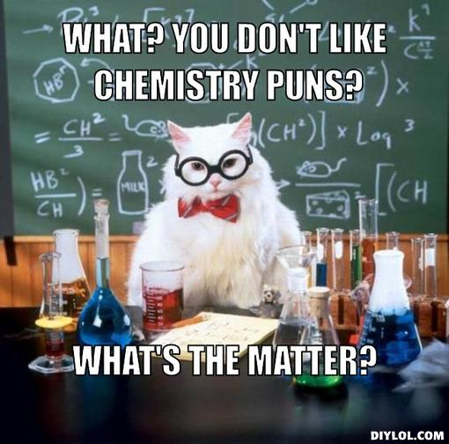
Basic Chemistry

Slide 2
Elements
An element is a pure substance that can’t be broken down into simpler substances by chemical methods. They are made up of one type of atom.
Examples: Helium (He), Carbon (C), Nitrogen (N), Oxygen (O), Silicon (Si)

Slide 3
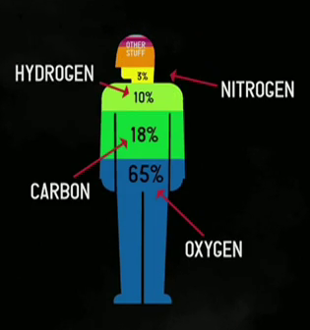
The Most Essential Elements for Life

Slide 4
Elements
We abbreviate elements using a one or two letter symbol
Do you know any symbols for any elements??

Slide 5
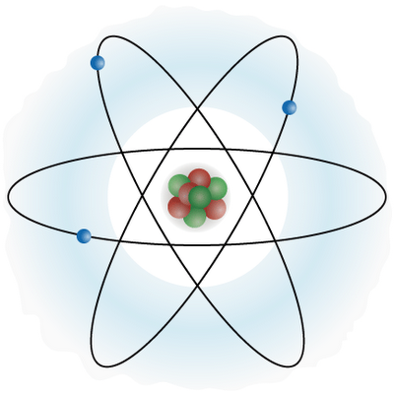
Atoms
The smallest unit of matter that still has the properties of that element
What do we mean by properties???

Slide 6
Atoms are made of three subatomic particles:
Protons are positively charged (+)
Neutrons are without a charge (0)
Electrons are negatively charged (-)
Notes:
A neutron walks into a bar and orders a drink. Upon being asked the price, the bartender responded, “For you? No charge”

Slide 7
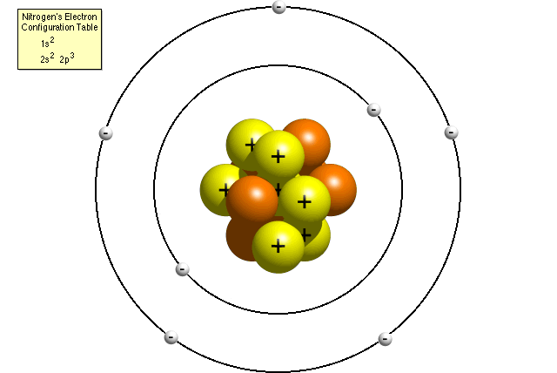
Where do all these particles live?
Protons (+) and Neutrons (0) live in the nucleus
Electrons (-) orbit around the nucleus

Slide 8
Different drawings of an atom

Slide 9
Do these particles get along?
Some of them have charge…which ones?
Protons have a positive charge
Neutrons have no charge
Electrons have a negative charge
Positively charged particles are attracted to negatively charged particles
So… opposites attract!!!
Things that have the same charge are repelled by each other.
So protons repel protons AND electrons repel electrons!

Slide 10
Information found on the Periodic Table
6
C
Carbon
12.011
Atomic Number = number of protons
Element’s Symbol
Element’s Name
Atomic Mass = protons + neutrons
In elemental forms, the number of protons will be the same as the number of electrons.
Carbon has 6 protons, 6 electrons, and an average of 6 neutrons.

Slide 11
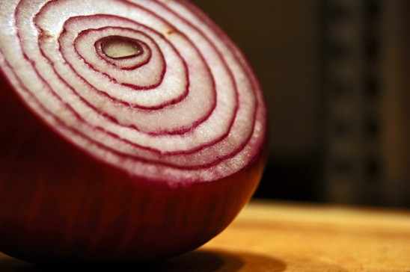
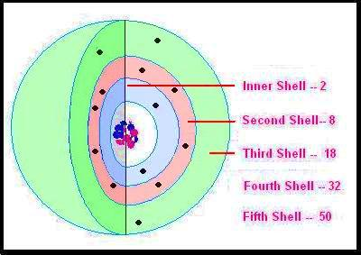
Are electrons just floating around in space?
Electrons are arranged in shells. They move around inside their shell, which surrounds the nucleus like layers in an onion
First Shell: 2
Second Shell: 8
Third Shell: 8

Slide 12
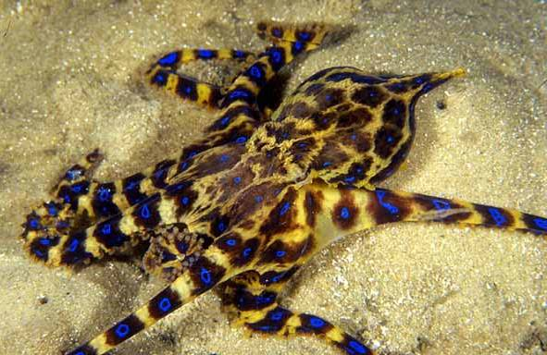
Electrons: The Outermost Shell
Elements are stable when they have full outer shells…this is called the octet rule because most outer shells can hold
8 electrons
8 is the MAGIC NUMBER!!!
Valence electrons are
those in the outermost
shell.

Slide 13
Charge
If an element has the same number of protons as electrons, it will have NO CHARGE.
For example, Carbon has six electrons. It also has six protons. 6e- = 6p+
Therefore, Carbon has no charge!
When an atom has more protons or electrons, a charge forms! Charged particles are called IONS.

Slide 14
But how does this happen?
Which subatomic particle can move?
The electron, right?
Sometimes electrons get given away, taken in, or shared between atoms!
If an atom GAINS an electron, it has a net NEGATIVE charge. (more electrons makes it -)
If an atom LOSES an electron, it has a net POSITIVE charge. (more protons makes it +)
Notes:
Two hydrogen atoms walk into a bar.
One says, “I think I’ve lost an electron.”
The other says, “Are you sure?”
The first replies, “Yes, I’m positive”.

