Slide 1
Biotechnology

Slide 2
What does technology mean?
the application of scientific knowledge for practical purposes, especially in industry
What does “bio” mean?
LIFE

Slide 3
Biotechnology Definition:
The use of microorganisms or biological substances to perform specific industrial or manufacturing processes

Slide 4
What are some examples of biotechnology?
Using bacteria to make yogurt and cheese
Genetically modified food crops (corn, soybeans, etc)
Drug manufacturing
Drug development
Disease studies

Slide 5
How can biotechnology be used to help people??

Slide 6
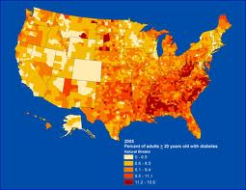
Diabetes
Diabetes is usually a lifelong (chronic) disease in which there are high levels of sugar in the blood.
25.8 Million people have diabetes in the world
How is Diabetes treated?

Slide 7
Diabetes is treated with insulin!!!
Insulin is a hormone that makes the liver absorb glucose from the blood stream
How do we make insulin?

Slide 8
Recombinant DNA
Genes from different species are combined together and placed into cells
The desired gene is cut out of the donor and transferred into the recipient DNA using restriction enzymes
Recipient DNA is often a plasmid (circular DNA found often in bacteria). Plasmids are used to transport desired DNA strand
The 2 samples are combined and make a hybrid DNA
Hybrid DNA gets inserted into bacteria which multiply with the recombinant DNA inside

Slide 9
Recombinant DNA
http://www.youtube.com/watch?v=8rXizmLjegI

Slide 10
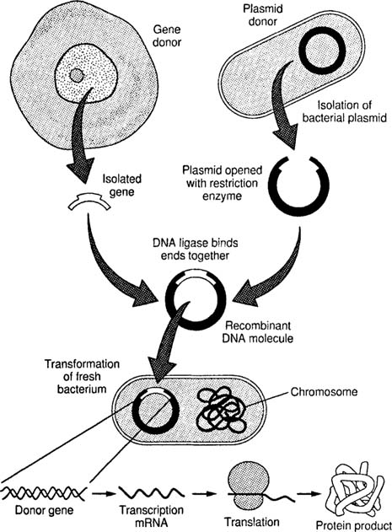

Slide 11
Recombinant DNA- Insulin Production
1) Plasmid DNA found in bacterium
2) Plasmid DNA cut by restriction enzymes
3) Desired gene (insulin) inserted into plasmid
4) Plasmid gets re-inserted into cell
5) Overtime the plasmid gets incorporated into DNA of cell and cell will start producing the desired product (insulin)
http://www.abpischools.org.uk/page/modules diabetes/diabetes6.cfm?coSiteNavigation_allTopic=1

Slide 12
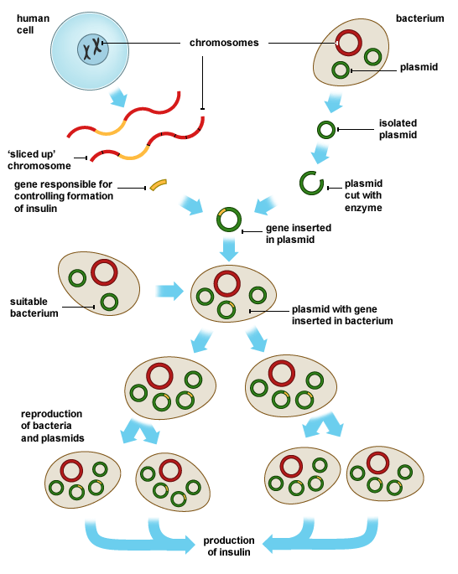

Slide 13
Genetically modified food
These fish are the same age, but the one on the bottom is growing much slower. The fish on the top has been genetically modified to grow faster.
These tomatoes were grown in the same field. The tomatoes on the left have been eaten by pests while the tomatoes on the right are untouched because they were genetically modified to be pest resistant.

Slide 14
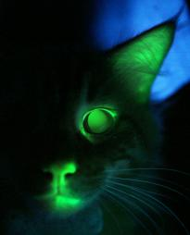
Mr. Green Genes, a transgenic cat Green fluorescence protein, or GFP, was inserted into his genome using recombinant DNA technology. GFP fluoresces (glows) when exposed to a blacklight

Slide 15
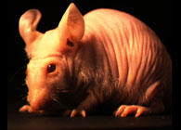
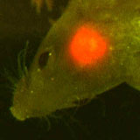
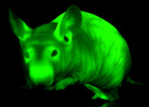
Studying
Cancer
Notes:
GFP is also being used to study the growth of tumors. If we can learn how they grow, we may be able to learn how to stop them. This is a picture of a hairless mouse that has GFP incorporated into every cell in its body. This is why it glows green under UV light! The picture on the left is a mouse that has a brain tumor. The tumor cells have a red form of GFP, so the scientists can study it growing!

Slide 16
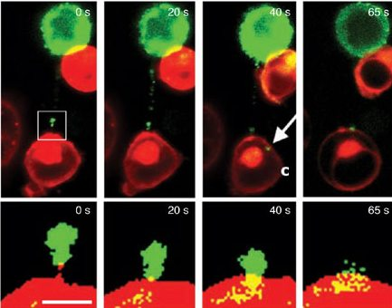
HIV Virulence
Notes:
HIV s is the virus that causes AIDS. This condition plagues people around the world, and especially in sub-saharan Africa. It atacks the immune system, and in most cases is deadly. We are learning how to fight this disease and potentially find a cure. Scientist have now used GFP to study how the virus moves throughout the body and infects different cells. T cells are cells that are important in your immune system. When T cells touch, there is a very thin connection between them for a small amount of space as they split apart. Scientists have used GFP to label the HIV virus, and through these pictures, you can see the virus traveling down this connection to infect the other T cell. Understanding how this virus works is a step toward finding a cure for this disease.

Slide 17
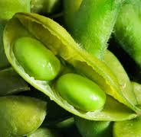
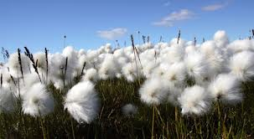
How do they genetically modify foods?
Recombinant DNA!
Desired genes are transferred to specific crops
Examples: bigger size, specific nutrients, resistance to drought or pests

Slide 18
Pros
Genetically Modified (GM) crops can be made resistant to viruses, fungi and bacterial growth.
-GM crops can be engineered to grow faster.
-GM crops can be engineered to be pest-resistant
-GM crops can be engineered to tolerate extreme weather conditions
-GM crops can be engineered with added vitamins and minerals, which is especially beneficial in third world countries dealing with malnutrition

Slide 19
Cons
There are a lot of unanswered questions
What are the long term health effects?
Can GM foods cause new allergies?
What are the effects on the environment?
What’s next…genetically modified animals?
We do not fully understand the effects GM food can have on our world

Slide 20
How can you tell your food is genetically modified?
A warning label is currently not required
To know, look for common GM ingredients
Soy lecithin
Fructose
Dextrose
Rapeseed oil
Cottonseed oil
Most corn syrups or corn starches
Some foods are labeled GMO Free

Slide 21
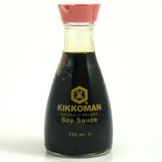
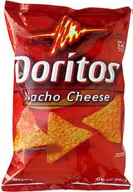
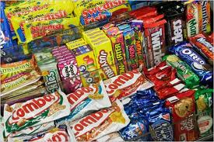
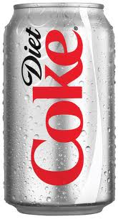
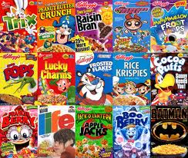
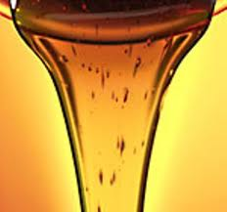
More common than you think….

Slide 22
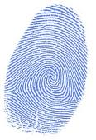
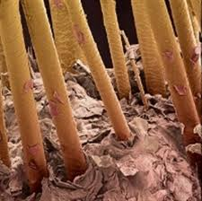
Crime Scene Investigation
Latex gloves: Fingerprints
Hairnet, face mask etc.?? …
…...DNA FINGERPRINTS!
(DNA is not an actual fingerprint)
Notes:
DNA

Slide 23
DNA Fingerprinting
Each organism has their own unique DNA fingerprint
A person’s DNA fingerprint can be used to identify a suspect in a crime
A sample of DNA from a crime scene can be matched to a sample taken from a suspect
What technology is needed to match the DNA samples?

Slide 24
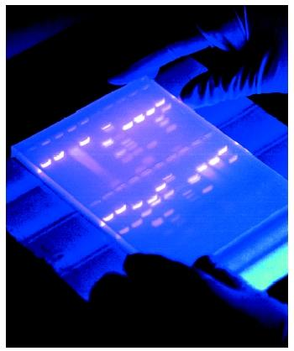
Gel Electrophoresis
Gel Electrophoresis is a technique used to separate molecules based on size
The size of the fragments are unique to each person so it creates a DNA fingerprint

Slide 26
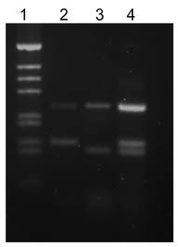
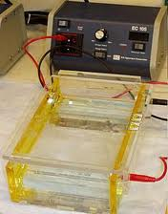
Gel Electrophoresis

Slide 27
Restriction Enzymes
Humans contain enzymes that make cuts in the DNA at specific places
These cut sites are randomly located on our DNA
By adding these enzymes to a DNA sample, varying lengths of DNA fragments are formed
The lengths of DNA fragments are unique to each individual
Notes:
The technique described above is another common forensics DNA technology called restriction fragment length polymorphism (RFLP). RFLP analyzes the length of DNA segments that have been cut at specific sites by restriction enzymes. Once the DNA has been cut into fragments, the length of the fragments is analyzed by gel electrophoresis.
Gel electrophoresis can analyze the length of DNA fragments by their length. The actual gel used is a substance that forms a matrix with very tiny holes randomly interspersed throughout it. When a sample of DNA is run through the gel, segments that are smaller are able to navigate through the holes more easily, and thus travel farther through the gel. A larger segment of DNA cannot weave through the holes as well, and thus will travel a shorter distance through the gel than a shorter segment in the same amount of time.
The DNA segments move through the gel by means of electrical current connected to the gel. The phosphate group in the backbone of the DNA molecule contains negatively charged oxygens, and gives the entire molecule and overall negative charge. Samples are loaded at the anode, or negatively charged end, and then the power is turned on. The negatively charged DNA molecules are attracted toward the opposite, positive end called the cathode, and thus begin to migrate through the gel.
Once the gel has been run, DNA fragments are visualized in bands that are made visible by fluorescent dyes added to the gel that bind to and stain DNA.
For more information, please visit http://www.ornl.gov/sci/techresources/Human_Genome/elsi/forensics.shtml
And
http://www.dnalc.org/ddnalc/resources/electrophoresis.html

Slide 28
How does gel electrophoresis work?
Restriction enzymes cut DNA
Pieces of DNA are run through a gel electrophoresis tray
The pieces of DNA are separated by weight and make a banding pattern that is unique to an individual (fingerprint)
Only about 10 regions are tested
The probability of having matching fingerprints is ~1 in 1 million

Slide 29
Which suspect is guilty?

Slide 30
Endangered Species
DNA can also be used to catalog endangered species
Endangered Birds: Collect feathers to identify DNA instead of trying to capture and mark every single bird
In most cases when DNA fingerprinting was used they got a higher number of species than when models were used

Slide 31
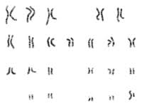
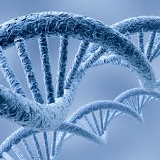
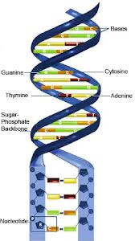
How many genes do humans have? What do they code for?

Slide 32
Human Genome Project
Aimed to sequence every single gene in humans!
1990-2003
Goals:
Identify ALL genes in human DNA
Determine sequence of the 3 billion base pairs
Store all information in database
Improve tools for analysis
Transfer information to the private sector
Address all ethical and legal issues
Implications???? http://www.youtube.com/watch?v=F5LzKupeHtw

Slide 33
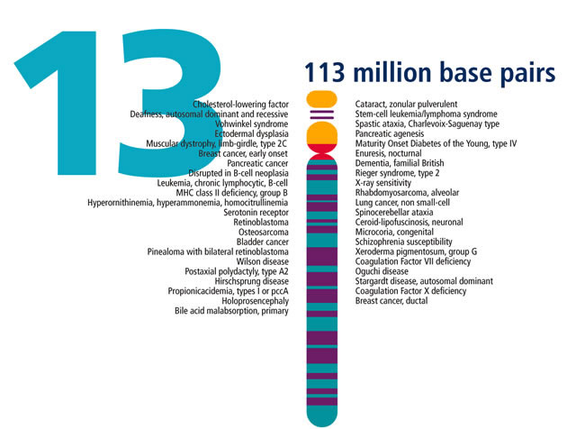

Slide 34
What did we learn?
We only have about 30,000 genes
A huge portion of our genome is non-coding, meaning it does not code for proteins
In order to make huge advances in diseases like cancer, the environment has to be taken into account
Gave rise to fields such as epigenetics : http://www.youtube.com/watch?v=kp1bZEUgqVI

Slide 35
Is it possible to fix a genetic mutation using biotechnology?? …Yes! Its called gene therapy!

Slide 36
Gene Therapy
Replacement of defective genes with healthy genes
Prevents or treats disease
Examples: cystic fibrosis, hemophilia, sickle-cell anemia, immune-deficiencies

Slide 37
Gene Therapy: Cystic Fibrosis
Cystic fibrosis is caused by a defective gene that causes humans to produce excessive amounts of mucus
This disease is life threatening
Gene therapy replaces that defective gene with a normal gene which causes the over production of mucus to stop

Slide 38
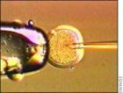
Cloning
Pin
Egg cell
Needle
Cloning is the production of genetically identical organisms from single cells
Bacteria and sponges often reproduce by cloning
Identical twins are natural clones (but not fraternal – why?)
First gene cloned mammal= Dolly the sheep

Slide 39
How it works…
Enucleate - The nucleus of an egg cell is removed and replaced with a nucleus taken from an adult organism
The egg is then placed in the reproductive system of a foster mother, where it develops normally
The nucleus from the adult organism will be identical to the offspring born

Slide 40
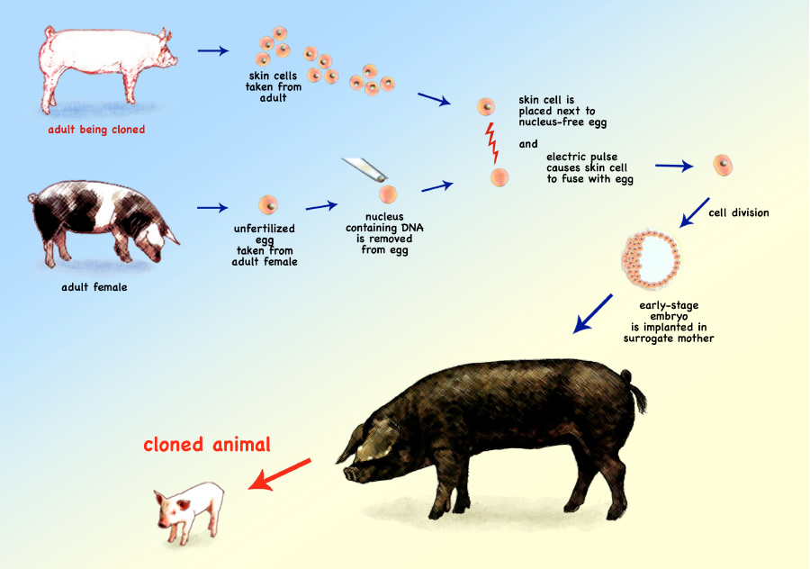

Slide 41
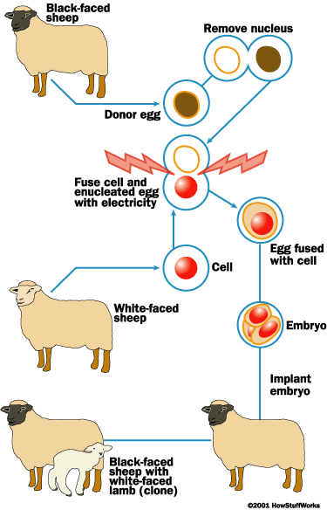

Slide 42
Animals that have been cloned
Fish
Cats
Cattle
Deer
Dog
Ferret
Fruit Flies
Goat
Horse
Mice
Mule
Pig
Rabbit
Rat
Rhesus Monkey
Sheep
Water buffalo
Wolf

Slide 43
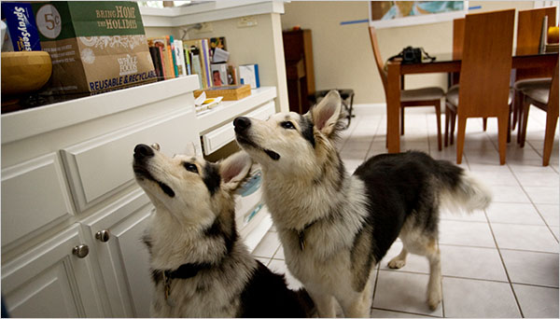
Pets cloned
These dogs, Mira and Missytoo, were both cloned from a dog that died in 2002. They are owned by Lou Hawthorne of California. Mr. Hawthorne owns BioArts, a company with offices in California and laboratories in South Korea. The company offers pet cloning for around $150,000.

Slide 44
Current debate
December 28^{th,} 2007 - FDA said cloned animals are safe to produce and eat
Waiting for consumer approval - has not happened yet
People already eating food from cloned animals
United States bans human cloning of all types including organs.

Slide 45
Stem Cells
Stem cells are cells that are undifferentiated
This means they can become any cell, in any part of the body, and they can theoretically divide without limit to replenish other cells as long as the person is alive
Found in all multi-cellular organisms

Slide 46
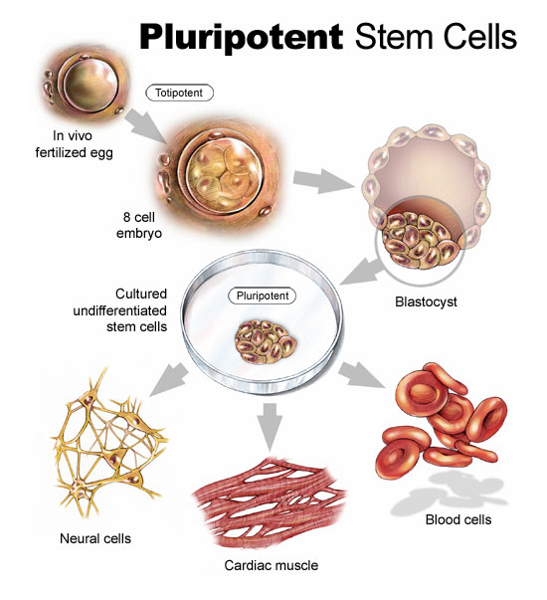

Slide 47
2 types of stem cells
Embryonic: taken from a fertilized egg, about 4-5 days old. They can become any of your 200 cell types.
Somatic: Found in bone marrow and the umbilical cord. Not as effective as embryonic stem cells and are limited to what they can become.

Slide 48
The controversy
Embryonic
Requires destruction of a human embryo (zygote)
Recently single cell biopsies have been done that can allow cell creation without embryo destruction!

Slide 49
Latest research
It is possible to create a stem cell using adult cells (no embryos needed) but the down side is that these adult cells are more likely to form tumors.
Finding new stem cells in amniotic fluid could be an alternative to embryonic stem cells
In March 2009, President Obama lifted restrictions on stem cell research. This will allow scientists to conduct research on already-existing stem cell lines.

Slide 50
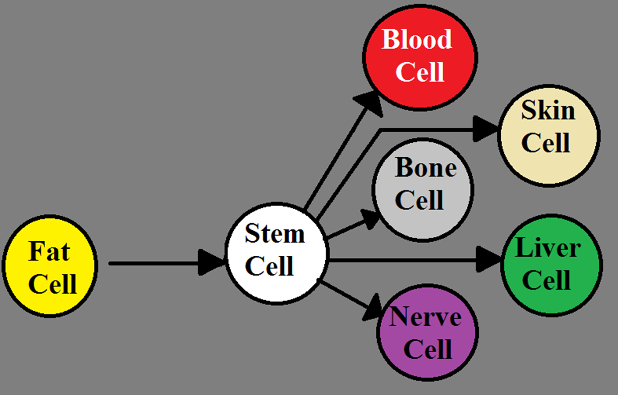
What are the ultimate goals of stem cell research.
Notes:
The ultimate goals of stem cell research is to be able to take a cell out of someone’s body, revert it back into a stem cell in the presence of certain chemicals and then to be able to change these stem cells into other types of cells that are less plentiful. The plentiful cells are fat cells and they can be very plentiful since everyone (at least in America) has some to spare, and there are thousands of pounds of liposuction tissue that is simply discarded every year. As the chemicals that revert the cells back into stem cells is being discussed, it is important to reinforce to the students that the chemicals are acting on the DNA, both to change a cell back to a stem cell and to differentiated into a new cell type. The hope for the future is to not have to use embryos for research to prevent any ethical concerns from interjecting into the research.
Now the students will break up in groups, pairs, or work alone for 5-10 minutes in order to create a list of possible applications for this new science. Tell the students that they can be creative as they want but make sure they stay in the lines of reality. Some main topics of stem cell possibilities are shown in the next slide.

Slide 51
Uses of stem cells
MANY !!!!!!!!!!!!!!
Possible cure for many genetic diseases
Alzheimer's
Cancers
Parkinson's
Limb, organ re-growth
Spinal cord injuries

