Slide 1
Human Body Systems

Slide 2
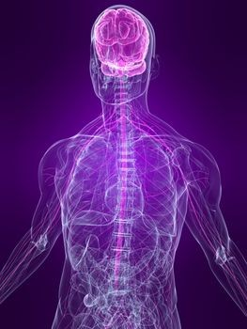
The Nervous system
Purpose: recognizes and coordinates the body's response to changes in its internal and external environments

Slide 3
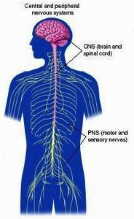
CENTRAL NERVOUS SYSTEM (CNS)
PERIPHERAL NERVOUS SYSTEM
Brain and Spinal Cord
All the nerves that carry messages to and from the CNS
Somatic Nervous Autonomic Nervous
System System
(voluntary) (involuntary)
to/from skin and to/from internal
skeletal muscles organs

Slide 4
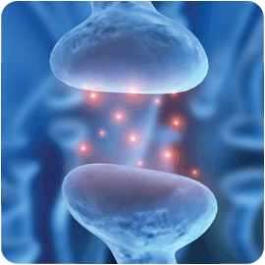
Neurotransmitters
Chemicals that diffuse across synapses between neurons (nerve cells)

Slide 5
How it Works:
Someone taps you on the shoulder
Sensory neurons transmit the touch message
Interneurons receive the message
Motor neurons transmit a response message
Neck muscles are activated and the head turns

Slide 6
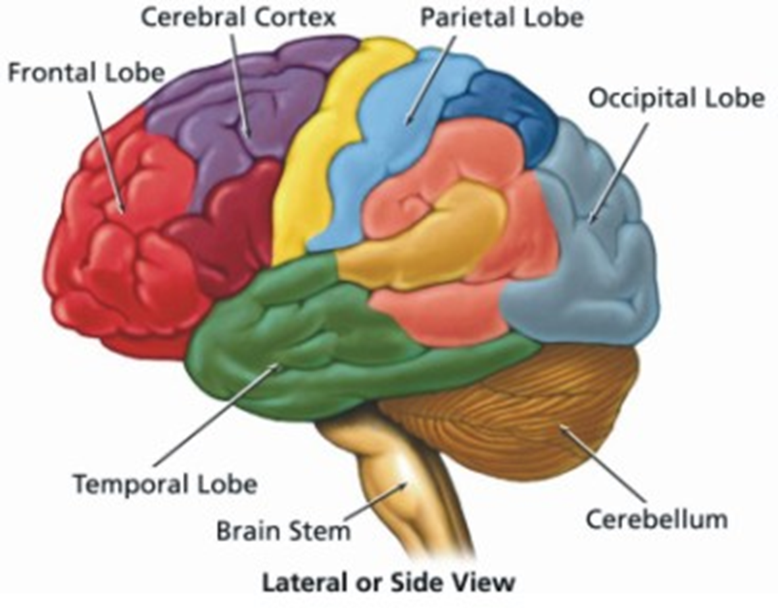
Anatomy of the brain
The brain is the “control center” of the nervous system
Cerebrum: divided into LEFT and RIGHT hemispheres
Controls:
Conscious activities
Intelligence
Memory
Language
Skeletal muscle movements
Senses
Cerebellum: located at back of brain
Controls: Balance, Posture, Coordination

Slide 7
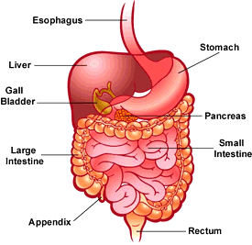
The Digestive system
Purpose: converts food into simpler molecules that can be used by cells; absorbs food; eliminates waste
The entire digestive process takes between 24 and 33 hours

Slide 8
Two types of Digestion
Physical
Chewing
Peristalsis
Chemical
Hormones
Enzymes
pH
Notes:
Gastrin = hormone secreted in the presence of food. Tells body to start making gastric juices

Slide 9
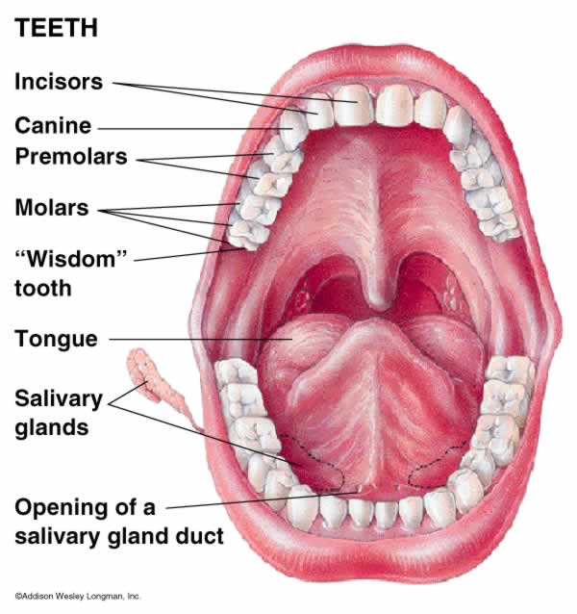
CHEWING
Increases surface area of food for digestion
Enzymes in mouth start to break down food (ex: Salivary Amylase)

Slide 10
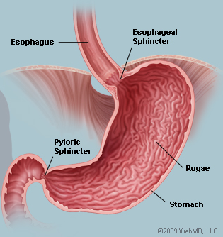
DIGESTION
Stomach = J-shaped organ that can store up to 2L
Gastric Juice
HCl (pH 2)
Pepsin: breaks down proteins into smaller peptide chains

Slide 11
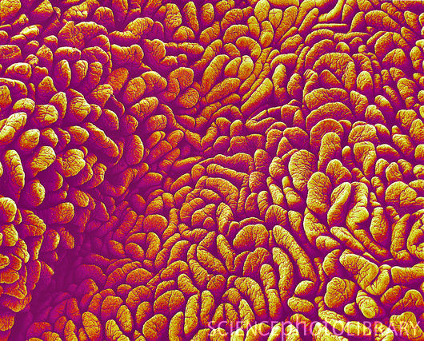
ABSORBPTION
Small intestine absorbs most of the nutrients
Water is absorbed in large intestine

Slide 12
WASTE REMOVAL
Elimination of indigestible material through rectum
I think you know how this works. No picture necessary!

Slide 13
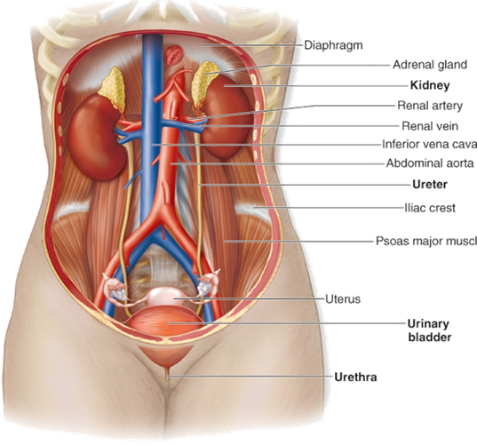
Excretory system
Purpose: eliminates waste products from the body

Slide 14
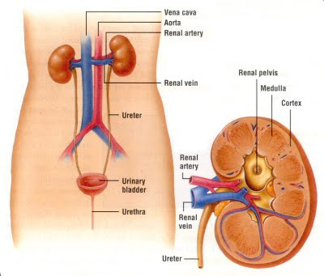
Main components
2 kidneys: filter waste out of blood
Ureters: tubes leading from kidney to bladder
Urinary Bladder: stores urine
Urethra: carries urine out of the body

Slide 15
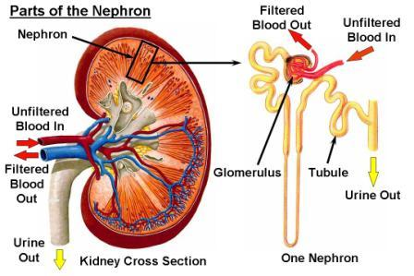

Slide 16
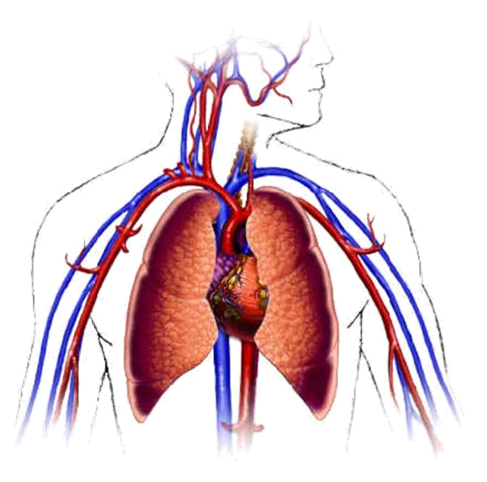
Circulatory System
Purpose: brings oxygen, nutrients and hormones to cells; fights infections; removes cell wastes; regulates body temperature

Slide 17
The Three Major Parts of the Circulatory System
Blood
complex mixture of cells and fluids
Blood Vessels
tubes to carry the blood
Heart
muscle to pump the blood

Slide 18
Blood Vessels
Arteries
bring blood from the heart to body tissues and organs
Veins
bring blood back to the heart from body tissues and organs
Capillaries
-Exchange gases and water (via diffusion)
very tiny vessels (as small as one cell thick!)

Slide 19
Systemic “Stops”
Digestive System
nutrients absorbed through diffusion in capillaries and sent throughout body
Cells in the Body
blood drops off oxygen and nutrients (so the cells can do their jobs)
blood picks up carbon dioxide and urea (the waste products of metabolism)
Kidneys
remove urea, some water, and some salts for later excretion as urine

Slide 20
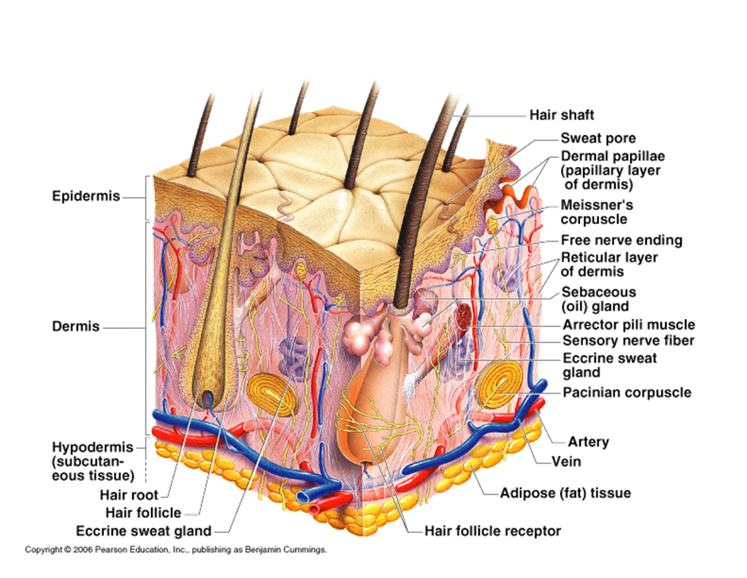
Integumentary System
Purpose: barrier against infections and injury; regulates body temperature; protects against ultraviolet radiation

Slide 21
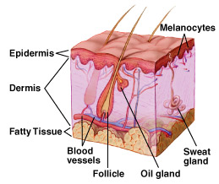
Integument = Skin
Skin is largest organ in body
Regulates body temperature and water loss
Functions as sensory organ
Produces Vitamins
Vitamin D
Protects internal tissues
Muscles, bones, organs
Hairy and Hairless skin

Slide 22
Muscular System
Purpose: produces voluntary movement; circulates blood, moves food through digestive system

Slide 23
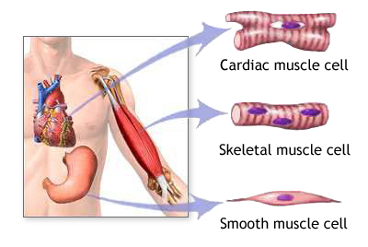
Muscles: 3 types
Smooth Muscle: involuntary; no ridges
Ex: Gastrointestinal tract
Cardiac Muscle: involuntary; striated
Ex: Heart
Skeletal Muscle:
voluntary; striated
Ex: Hamstring, Bicep,
Tricep

Slide 24
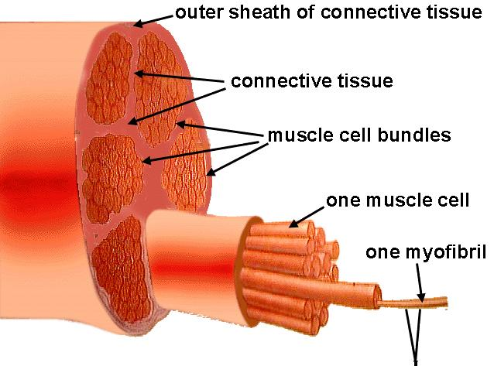
Skeletal Muscle
Myofibril = muscle fiber
Muscle fibers contain actin and myosin (proteins) that work together to allow
your muscles to
move!

Slide 25
Skeletal System
Purpose: supports the body; protects internal organs; allows movement; stores mineral reserves; provides blood cell formation

Slide 26
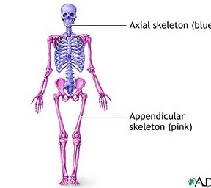
Bones
Bones provide structural support and movement
Axial vs. Appendicular Skeleton
Axial: skull, spine, ribcage
Appendicular: arms legs

Slide 27
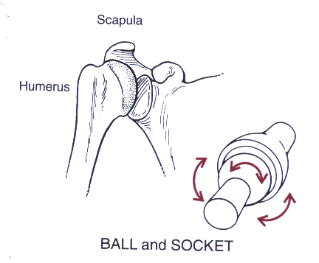
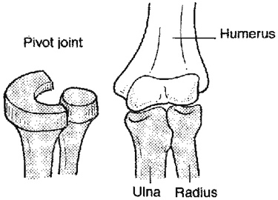
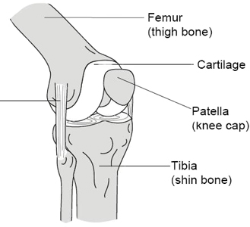
Joints: Where bones meet
3 types:
Ball & Socket (shoulder, hip)
Pivot (elbow)
Hinge (knees)

Slide 28
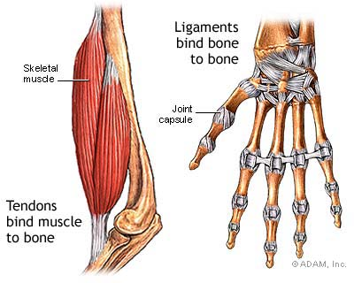
Ligaments vs. Tendons
Ligaments: attach to bone to bone
Tendons: attach muscle to bone

Slide 29
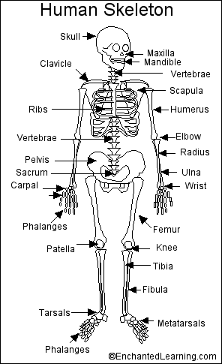
Your Bones! (just some)

Slide 30
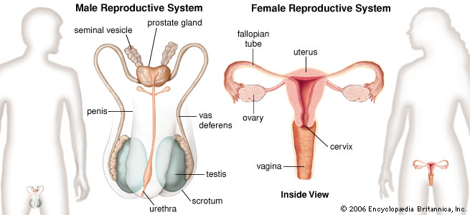
Reproductive System
Purpose: produces reproductive cells; in females nurtures and protects developing embryo

Slide 31
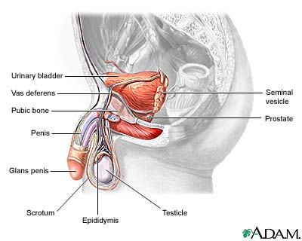
Organs/Components
Males
Penis
Testes
Site of sperm production
Epididymis
Where sperm mature
Vas Deferens
Duct where mature sperm are stored before being transported to the urethra
Urethra
Transports sperm out of the male body

Slide 32
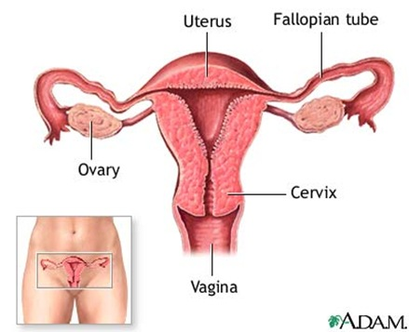
Organs/Components
Females
Ovaries
Where eggs mature
Fallopian Tubes
Tube connecting ovaries to the uterus
Uterus
Where a fetus develops during pregnancy
Vagina
Canal leading to the uterus

Slide 33
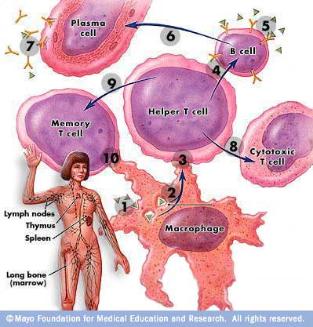
Immune System
Purpose - helps protect the body from disease; collects fluid lost from blood vessels and return it to the circulatory system

Slide 34
Organs/Components
White Blood Cells
Thymus
Spleen
Lymph Vessels
Lymph Nodes

Slide 35
Active vs. Passive Immunity
Active Immunity – body produces antibodies in response to an antigen
Passive Immunity – immunity passed from a mother to her offspring

Slide 36
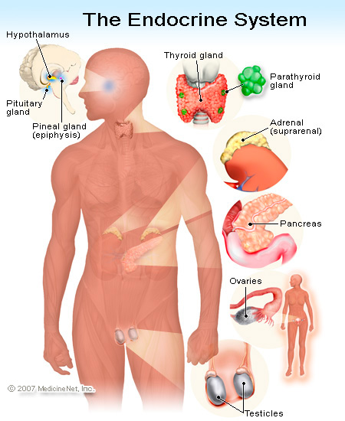
Endocrine System
Purpose - controls growth, development, and metabolism; maintains homeostasis

