Slide 1
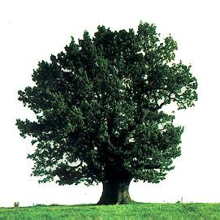
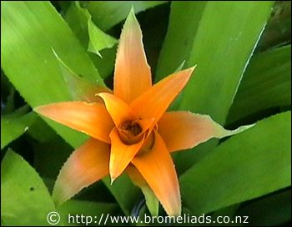
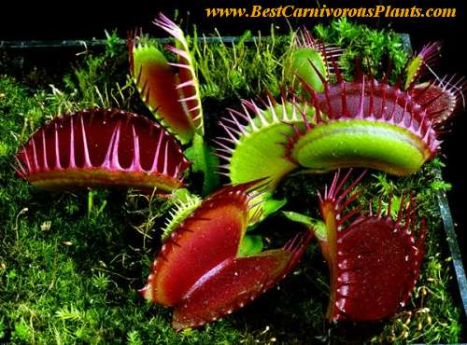
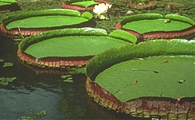
Introduction to Plants

Slide 2
What is a plant?
A multicellular eukaryote that can produce its own food through photosynthesis.
Since it can do this, it is an...
Autotroph!

Slide 3
Plants have thick walls made of
cellulose

Slide 4
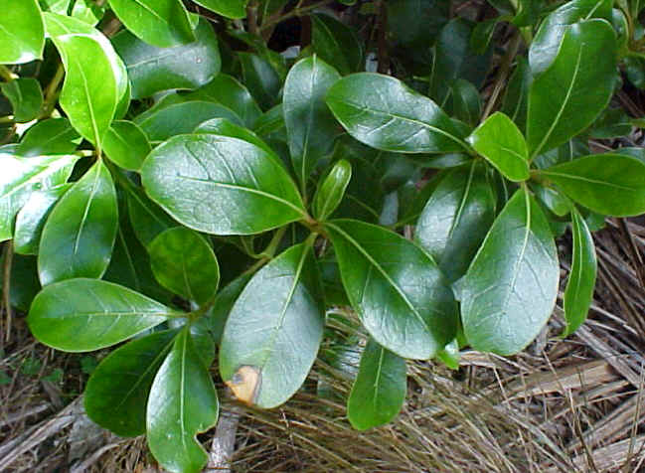
...and their stems and leaves have a waxy waterproof coating called a cuticle.

Slide 5
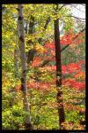
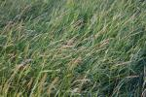
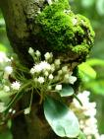
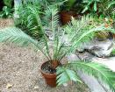
What are some examples of plants?

Slide 6
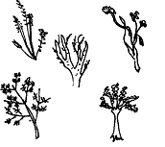
Plants first appeared around 500 million years ago. The earliest known plant fossils are psilophytes – very basic vascular plants.

Slide 7
The most likely ancestor of green plants is green algae.
Both have cell walls made of cellulose.
Both use chlorophyll for photosynthesis.
Both store food as starch.

Slide 8
Plant Phylogeny
Flowering
plants
Cone-bearing
plants
Ferns
Mosses
Flowers; seeds
enclosed in fruit
Seeds
Water-conducting
(vascular) tissue
Green algae
ancestor

Slide 9
Land plants have developed lots of adaptations to help them survive. What are some of these adaptations?

Slide 10
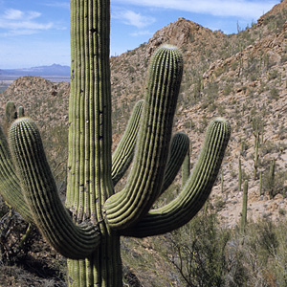
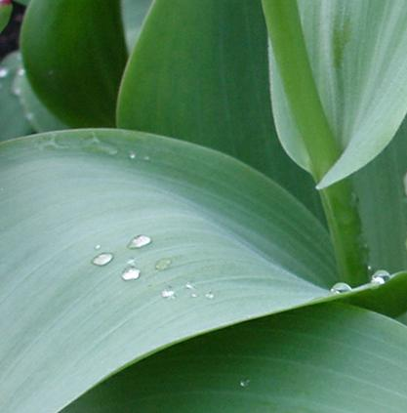
Preventing water loss:
The waxy cuticle creates a barrier that helps prevent water in the plant’s tissues from evaporating into the atmosphere.

Slide 11
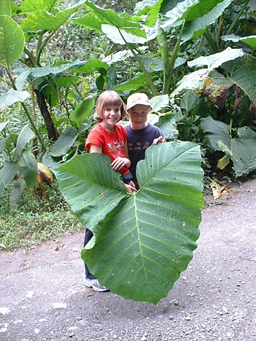
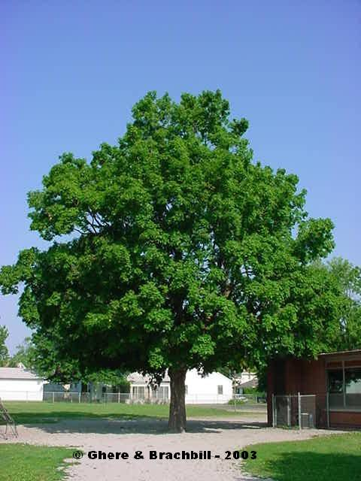
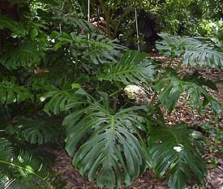
Obtaining Food:
Plants have leaves - broad, flat structures that obtain light energy for photosynthesis. The leaves are supported by the stem and grow upward toward sunlight.

Slide 12
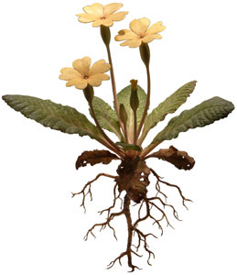
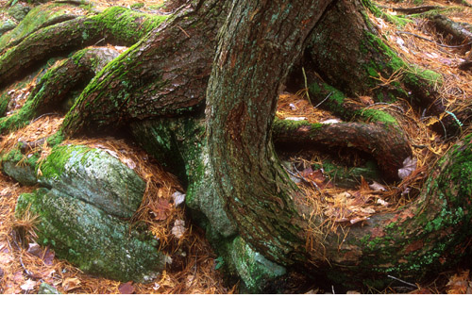
Roots:
Roots absorb water and minerals from the soil, transport water and minerals to the stem, and anchor the plant in the ground.

Slide 13
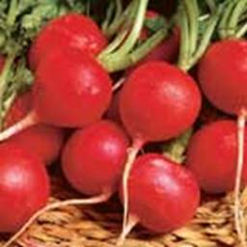
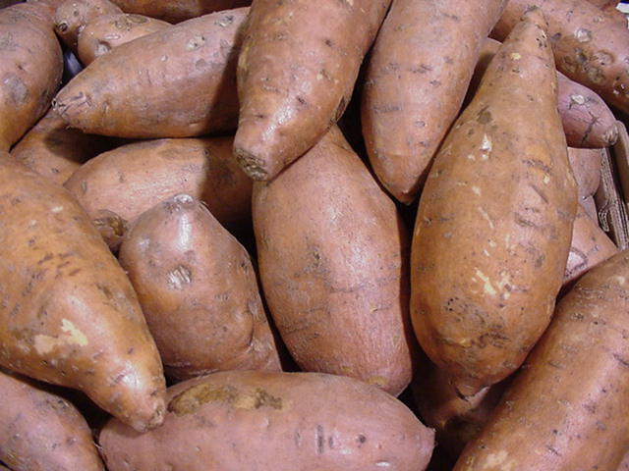
Some roots act as starch reserves, which some animals eat. (sweet potatoes and radishes are examples)

Slide 14
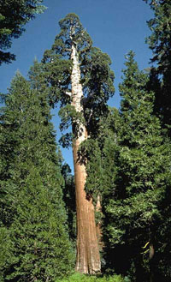
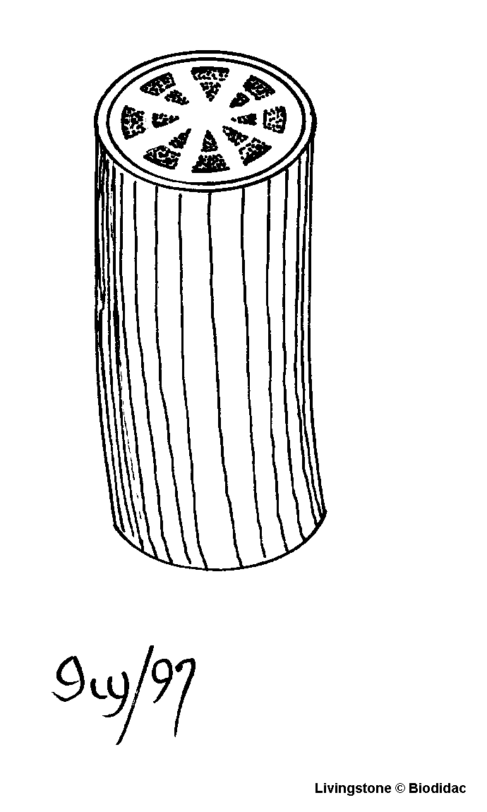
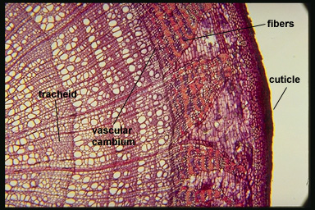
Transporting Materials:
A stem provides structural support and usually contains vascular tissues. Vascular tissues are made of tube-like cells which transport water and other materials.

Slide 15
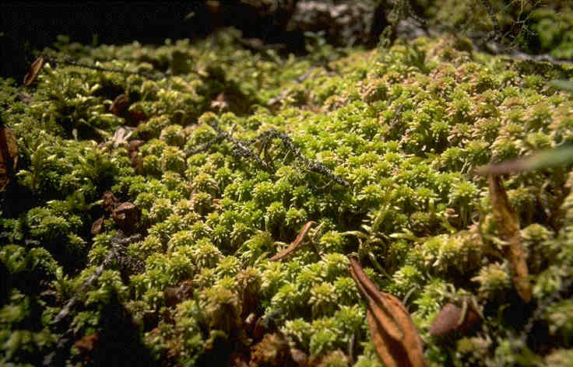
Very simple plants like mosses do not have vascular tissues to transport materials.
They are called non-vascular plants.

Slide 16
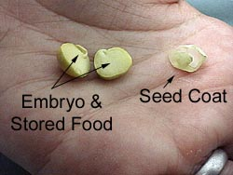
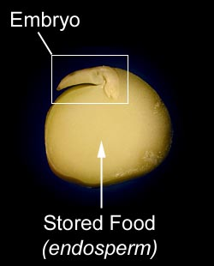
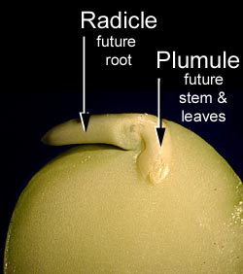
Reproductive strategies:
A seed contains an embryo and a food supply. It is surrounded by a protective coat. Seeds protect the embryo from drying out.

Slide 17
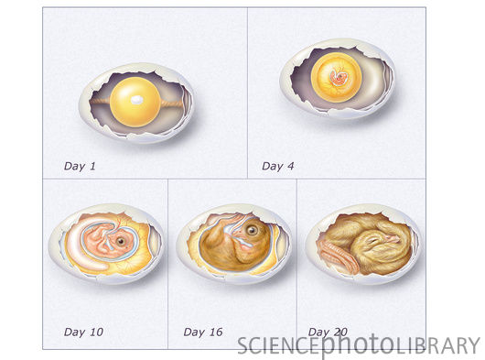
Seed is kind of like chicken’s egg!

Slide 18
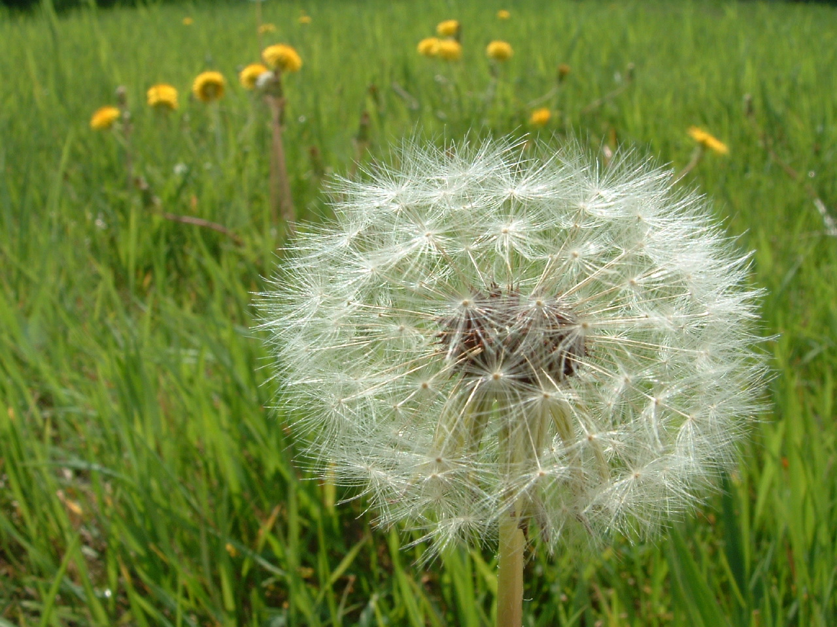
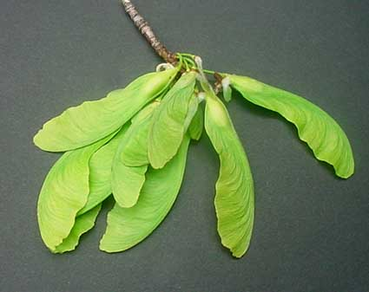
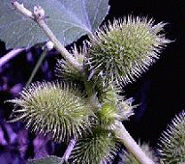
Seeds also might help with dispersal.
Each has a different adaptation
to allow it to spread

Slide 19
Alternation of Generations
Plant life cycles have two alternating life cycles occurring in 2 different structures:
The diploid (2N) phase is the sporophyte
The sporophyte makes spores
The haploid (1N) phase is the gametophyte
The gametophyte makes gametes
**Developed to protect the embryo as it grows

Slide 20
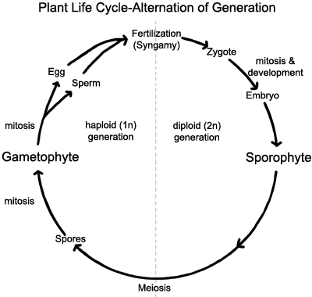
Sporophyte generation
begins with zygote

Slide 21
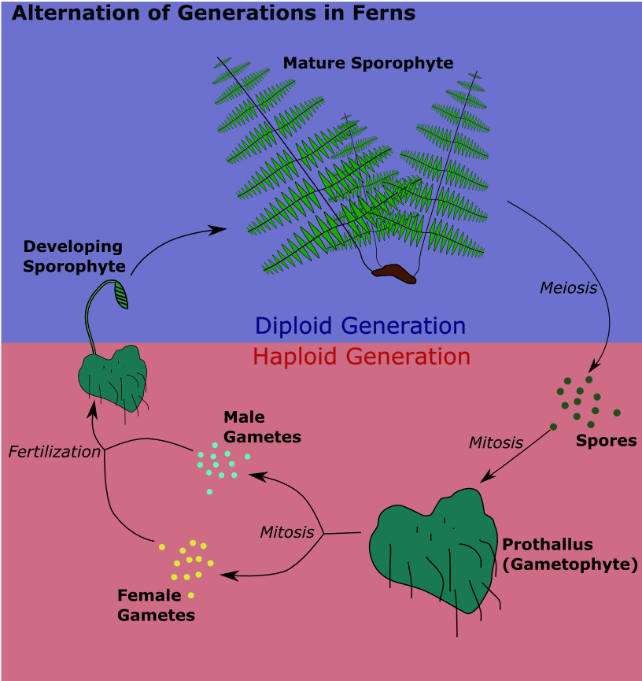

Slide 22
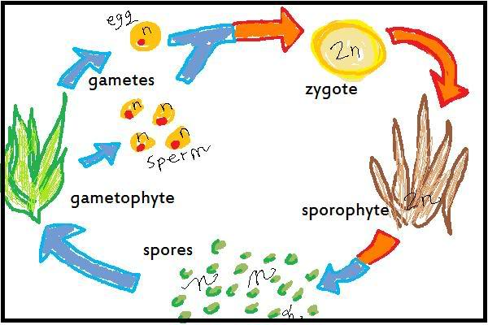
Gametophyte makes gametes through mitosis
2 gametes unite in fertilization to form a diploid zygote
Zygote divides and grows by mitosis and develops into a diploid sporophyte
Sporophyte produces spores by meiosis (spores are haploid)
Haploid spores divide and multiply by mitosis into a haploid gametophyte

