Slide 1
Flower Structure and Seed Dispersal
*IMPORTANT FOR SCAVENGER HUNT*

Slide 2
Angiosperm Reproduction
Flowers contain ovaries which protect the egg
Sperm needs to get to the egg
Once the egg is fertilized, it turns into a seed
Seed may be contained in a fruit
Seeds need to be dispersed (spread away from the parents)
So they don’t compete for nutrients

Slide 3
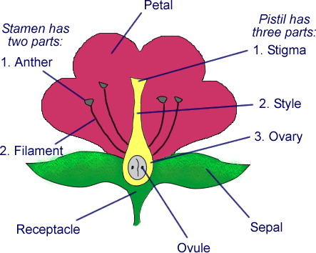
Flower Structure
Pistil =
female
reproductive
structure
Stamen =
male
reproductive
structure
Pollen grain reaches stigma→pollen tube is formed, allowing pollen to reach the ovule→ovule is fertilized→ovule develops into a seed

Slide 4
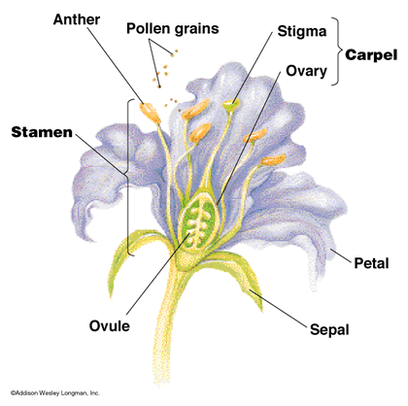

Slide 5
Angiosperms can be divided into Monocots and Dicots
Monocots | Dicots
Single cotyledon (first embryonic leaf) | Two cotyledons (first embryonic leaves)
Parallel leaf veins | Branched leaf veins
Flower petals in 3’s | Flower petals in 4’s or 5’s
Roots are fibrous | One big tap root

Slide 6
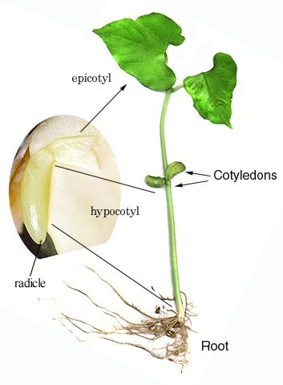
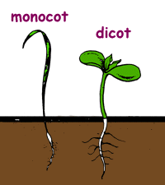
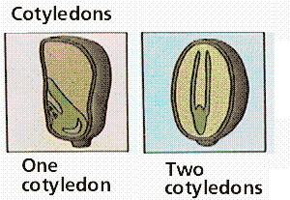
Seeds

Slide 7
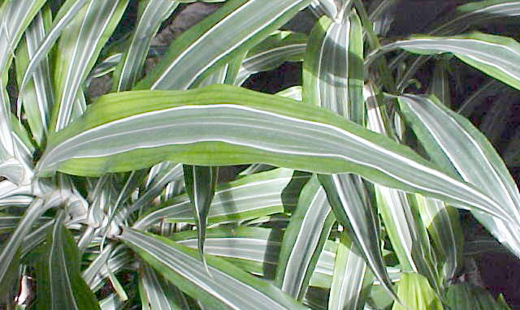
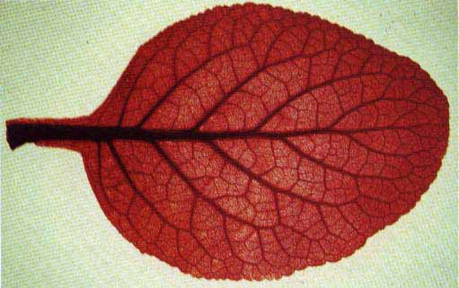
Leaf Vein Patterns

Slide 8
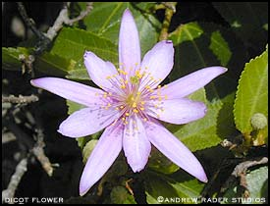
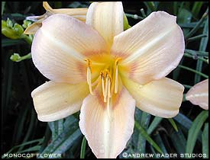
Flowers

Slide 9
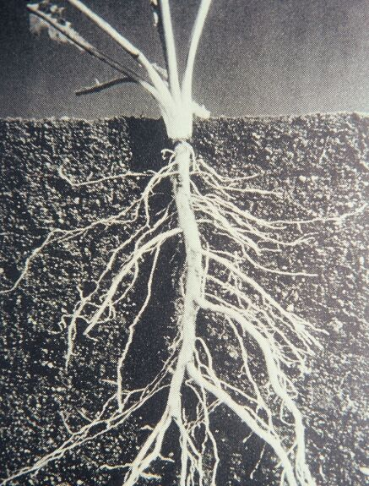
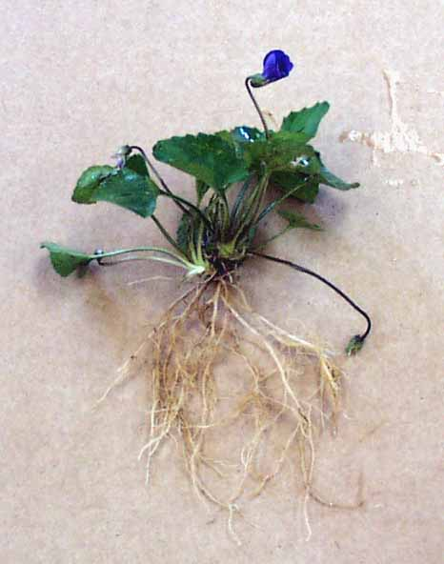
Roots

Slide 10
Stomata
Structures on plants usually found on outer leaf skin layer
Made up of 2 components
Stoma (opening)
Guard cells (cells surrounding the opening)
Allows communication between the internal and external environments of the plant

Slide 11
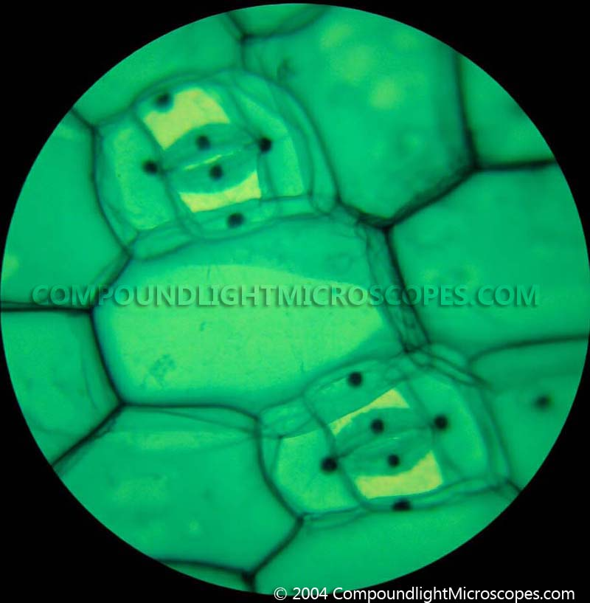
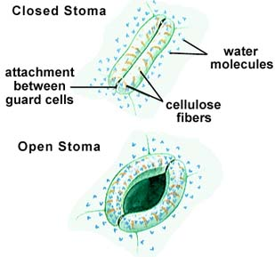
Stoma – leaf opening for transpiration

Slide 12
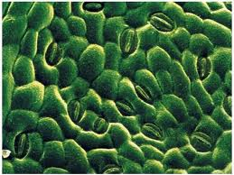
Physiological Function
As stoma opens, CO2 and sunlight enters
AND
As the stomata opens water vapor exits through the stoma

Slide 13
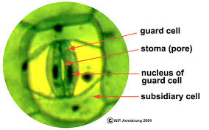
Guard Cells
Cells that surround the stoma
Guard cells swell by inflow of water and contract by loss of water
Turgor Pressure: the pressure exerted by water inside the cell
As turgor pressure increases, guard cells swell, opening the stoma

Slide 14
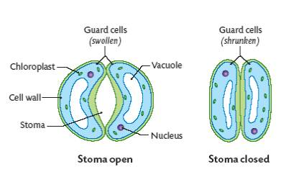

Slide 15
Homeostasis
An organisms ability to regulate its internal conditions
Example in humans?
How does the stomata achieve this in plants?

Slide 16
Homeostasis
As levels of atmospheric CO2 change, the stomata can respond
As availability of water changes, stomata can also respond
This keeps an overall balance in the plant’s biochemistry

