Slide 1
Classification and Taxonomy

Slide 2
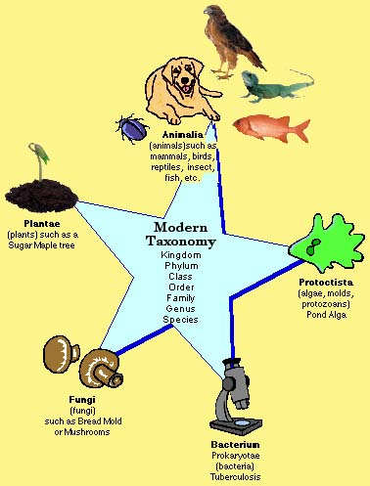
Taxonomy
The science of naming and grouping individuals

Slide 3
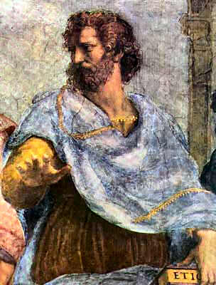
The first taxonomist was Aristotle,
He placed all organisms into two groups using simple names
Was he right?
Plant
OR
Animal
shrub
fly
crawl
tree
herb
swim

Slide 4
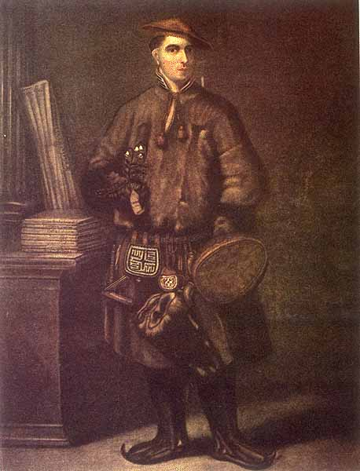
Carolus Linnaeus
Linnaeus was a Swedish botanist & physician
He grouped organisms based on their physical and structural similarities
Described organisms with two word names:
binomial nomenclature
First word = genus
Second word = species
What do you think “binomial nomenclature” means?

Slide 5
Binomial Nomenclature
Bi- two
Nomial- name
First word= genus
Second word= species

Slide 6
Why binomial nomenclature?
Scientific name - “two word naming system”
Uses Latin, a “dead”, unchanging language. Why is this a good idea?
Genus is written first, then species
Genus is capitalized, species is not. Both are italicized if typed, underlined if written.

Slide 7
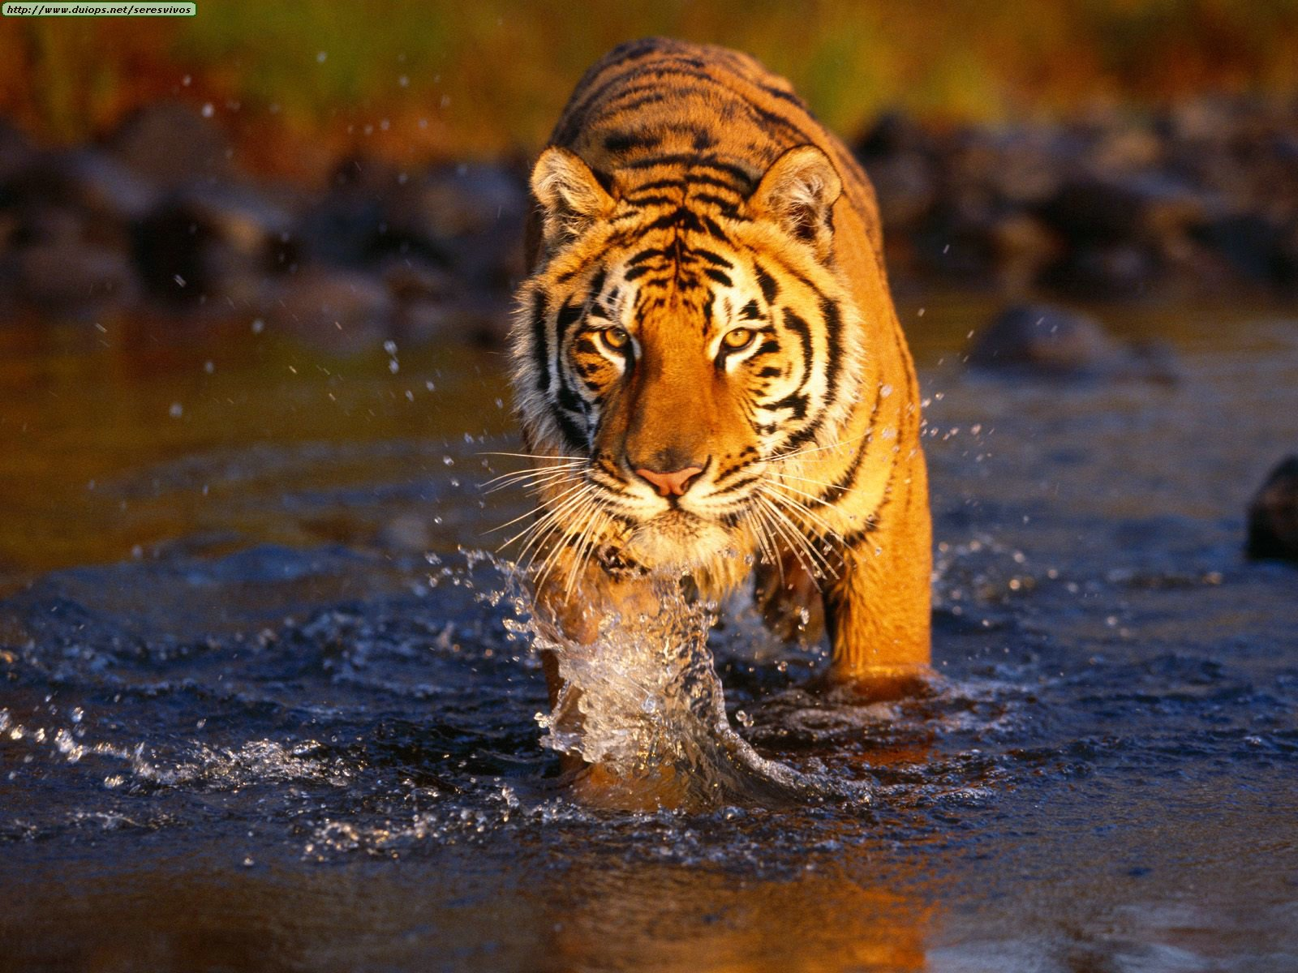
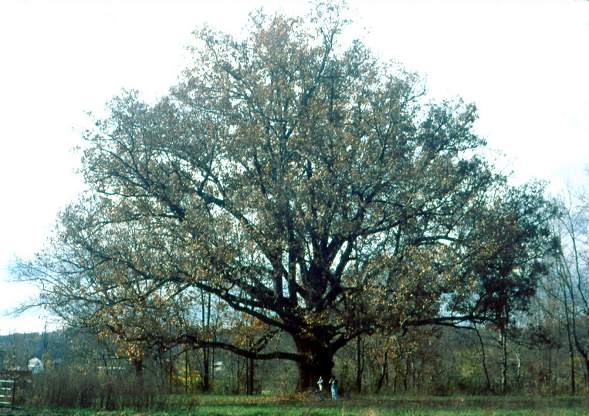
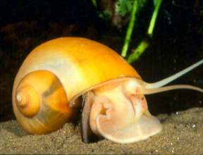
Some scientific names…
Homo sapiens
Canis lupus
Felis domesticus
Iguana iguana
Pan troglodytes
Panthera tigris
Pomacea bridgesii
Quercus alba

Slide 8
How do we go from broad generalizations such as animal and narrow down to a species, like homo sapiens?

Slide 9
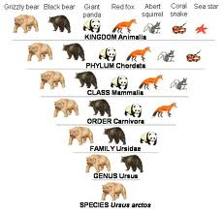
Taxonomic hierarchy
Names organisms and their relationships from very broad to very specific
7 levels!

Slide 10
Organisms are classified in a hierarchy
Kingdom (broadest)
Phylum
Class
Order
Family
Genus
Species (most specific)

Slide 11
Mnemonic Devices
King’s Play Chess On Fat Guy’s Stomach
King Philip Came Over For Green Spaghetti
Kangaroo Pouches Can Only Fit Green Skittles
Katie Plays Clarinet On Fast Green Skis
What can you come up with?

Slide 12
Human Giant Panda
Kingdom Animalia Animalia
Phylum Chordata Chordata
Class Mammalia Mammalia
Order Primate Carnivora
Family Hominidae Ursidae
Genus Homo Ailuropoda
Species sapiens melonoleuca

Slide 13
Do you think the method of taxonomy has to change?
What are some circumstances that may have changed the way we classify organisms?

Slide 14
Domains
Recently, some major differences between cell types became known.
This lead to the development of a new taxonomic category – the domain.
A domain is larger than a Kingdom.
There are 3 domains:
Domain Eukarya
Domain Bacteria
Domain Archaea

Slide 15
How would this change our mnemonic device?
“King Philip Came Over For Green Spaghetti” becomes……
Domineering King Philip Came Over For Green Spaghetti

Slide 16
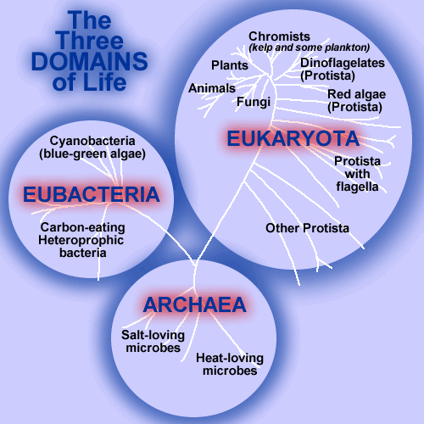

Slide 17
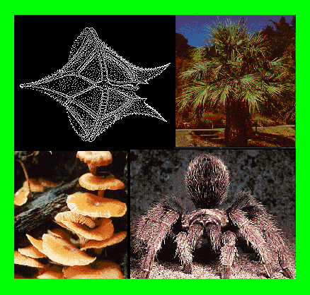
Eukaryota
Animals, plants, fungi, and protists
Ex: photosynthetic protists,
Mushrooms, spiders, trees

Slide 18
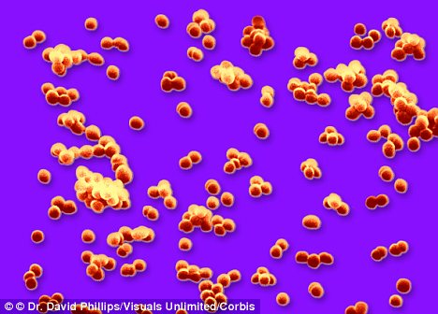
Eubacteria
“true bacteria”
Prokaryotic cells lacking a nucleus

Slide 19
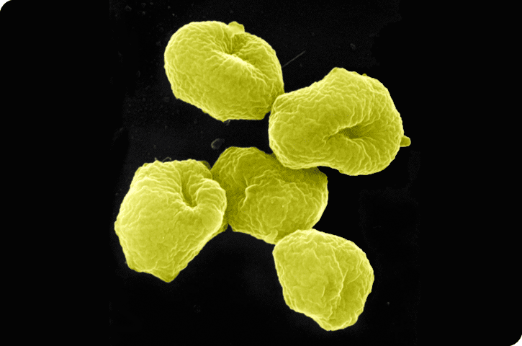
Archaea
Single-celled microorganisms
The ‘extremists” (high temp, high acidity etc.)
Sulfolobus

Slide 21
What does “species” mean??

Slide 22
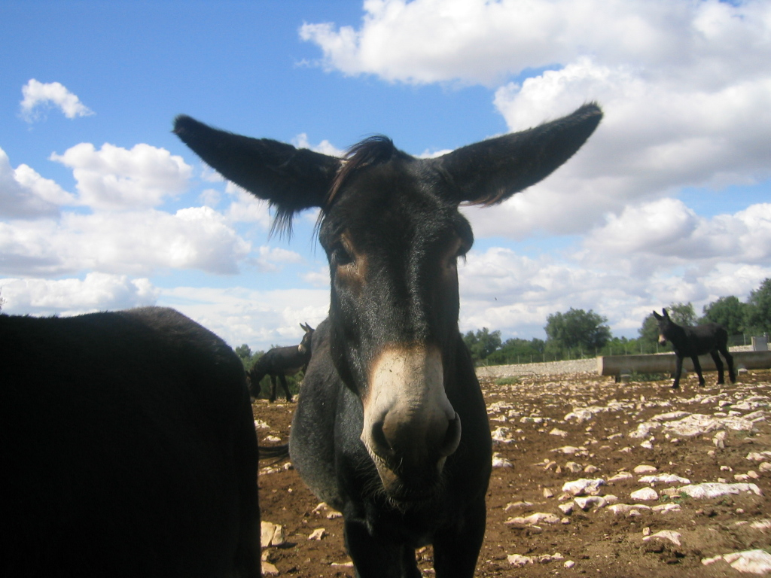
What does “species” mean?
Biological species concept
A group of actually or potentially breeding natural groups that are reproductively isolated from other groups. Ernst Mayr, 1924
Some problems:
Asexual organisms
Hybrids
Sterile offspring of two different species

Slide 23
How many species are out there?
There are probably around 10 million species worldwide, but estimates range from 5-30 million!
Over 5 million live in the tropics
Only 2 million species have been formally described (and over half of these are insects!!)
Each year, there are approximately three bird species discovered, many fish species, and countless insects and other small or microscopic organisms

Slide 24
How can we discover new species?

Slide 25
How do we discover new species?
DNA fingerprinting
Ex: More bird species found by DNA fingerprinting
Human microbe project
Ex: Attempting to identify EVERY single microbe in our bodies

