Slide 1
Alternation of Generations
Plant life cycles have two alternating generations:
a diploid phase (2N) and a haploid phase (N)
During alternation of generations, mitosis and meiosis alternate to produce the two types of reproductive cells – gametes and spores.
The diploid (2N) phase is known as the sporophyte, or spore-producing plant.
The haploid (N) phase is known as the gametophyte, or gamete-producing plant.

Slide 2
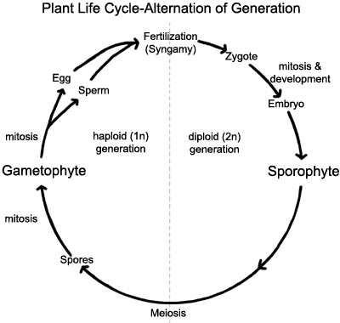

Slide 3
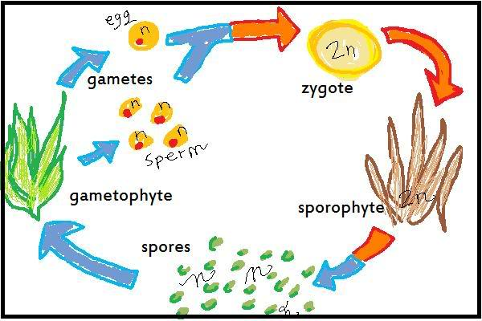
Gametophyte makes gametes through mitosis
2 gametes unite in fertilization to form a diploid zygote
Zygote divides and grows by mitosis and develops into a diploid sporophyte
Sporophyte produces spores by meiosis (spores are haploid)
Haploid spores divide and multiply by mitosis into a haploid gametophyte

Slide 4
Plant Divisions
Plants are divided into groups based on:
1. Presence or Absence of Vascular Tissue
Xylem – moves water from the roots up to the leaves
Phloem – moves sugars made in the leaves down to the roots
  Xylem goes high; phloem goes low
2. Whether or not they make seeds
3. Whether or not they have flowers

Slide 5
Plant Divisions, cont’d
The four groups are:
1. bryophytes (mosses)
2. pterophyta (ferns)
3. gymnosperms (cone bearers)
4. angiosperms (flowering plants)

Slide 6
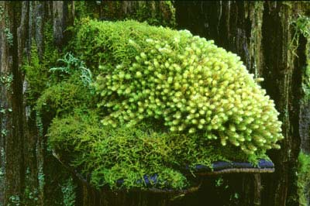
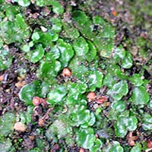
Bryophytes
Examples include mosses and liverworts

Slide 7
Characteristics of Bryophytes
Bryophytes do not have vascular tissue to move water/nutrients
  They don’t get very tall
Rely on osmosis to move water
No cuticle = rapid water loss

Slide 8
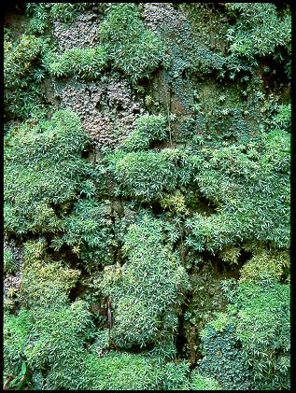

Slide 9
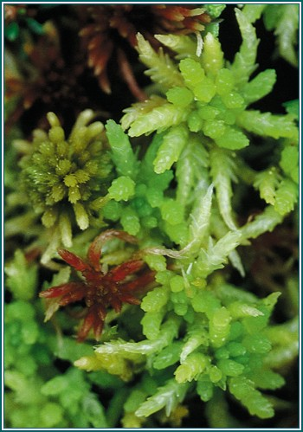
Sphagnum
(peat moss)

Slide 10
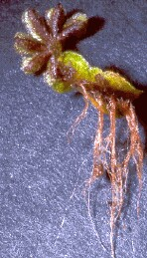
Mosses lack true roots but they have rhizoids to anchor the plant in the soil

Slide 11
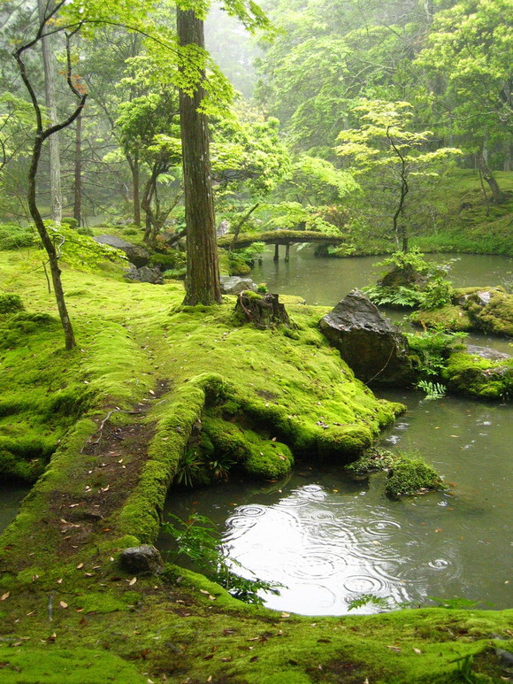

Slide 12
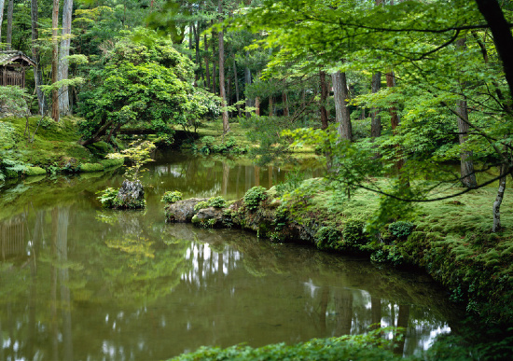

Slide 13
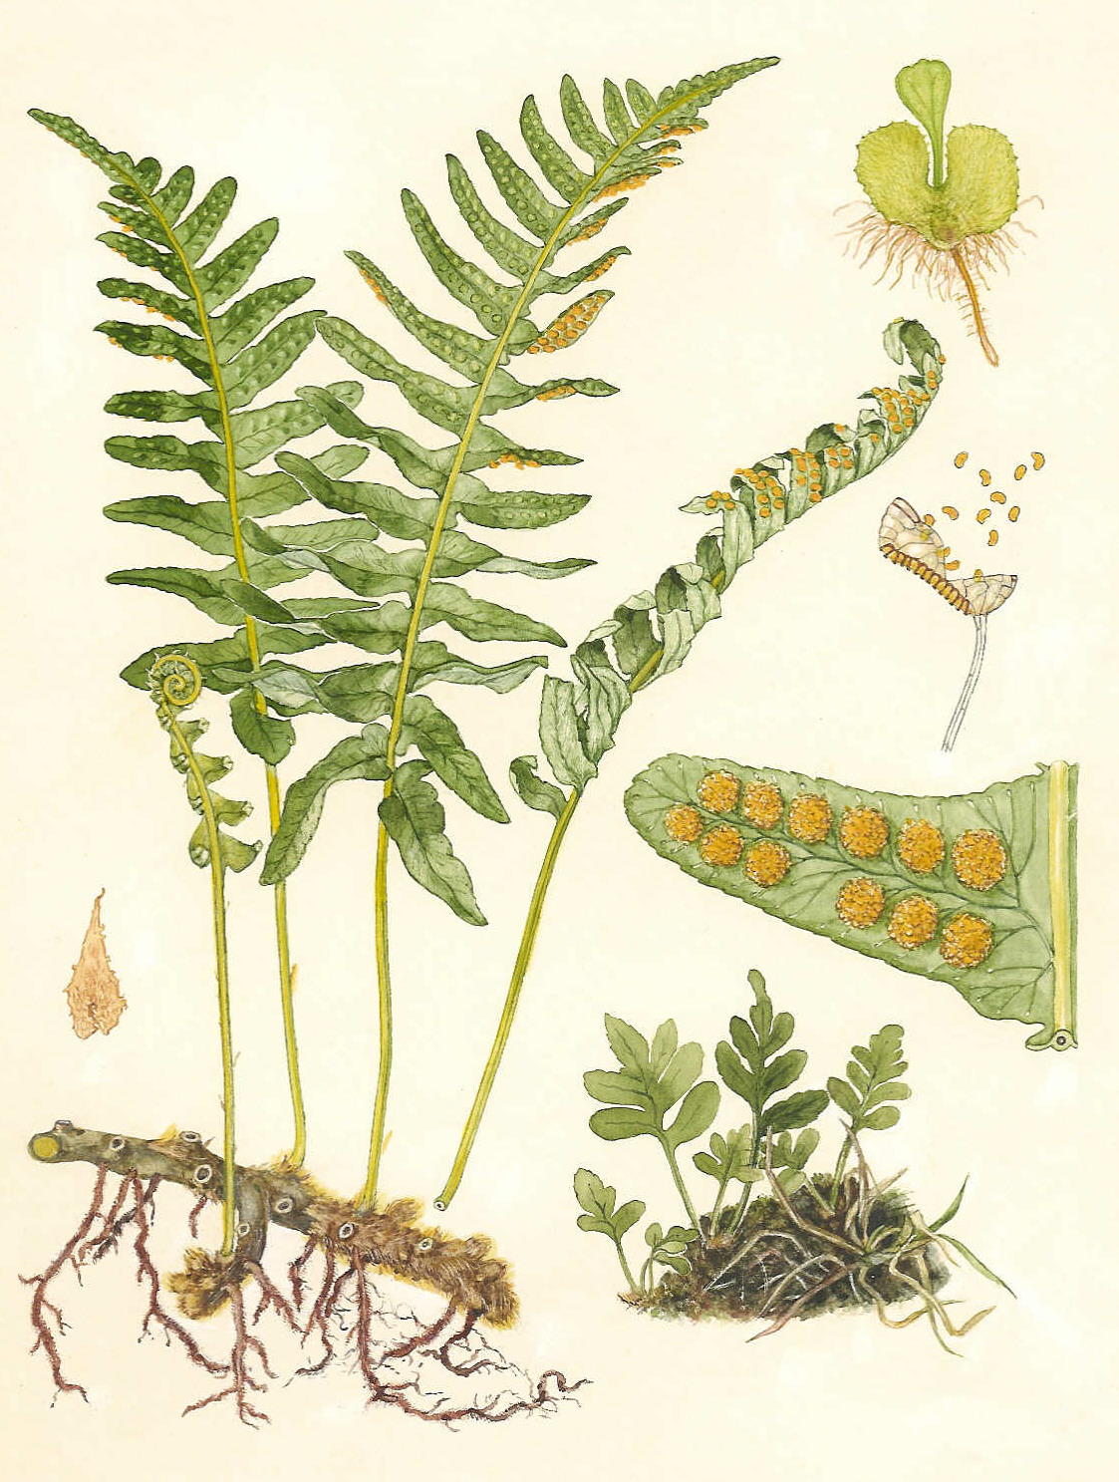
Ferns
Ferns are vascular
  they have xylem and phloem
Ferns are seedless plants; They make spores
Thick, underground stem = rhizome
Leaves are called “fronds”

Slide 14
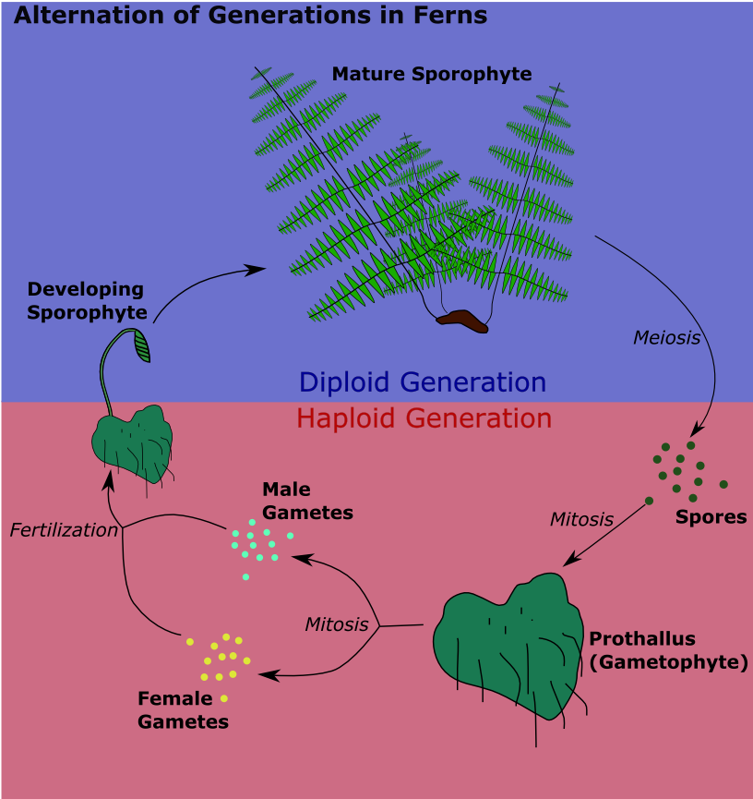

Slide 15
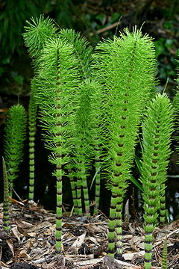
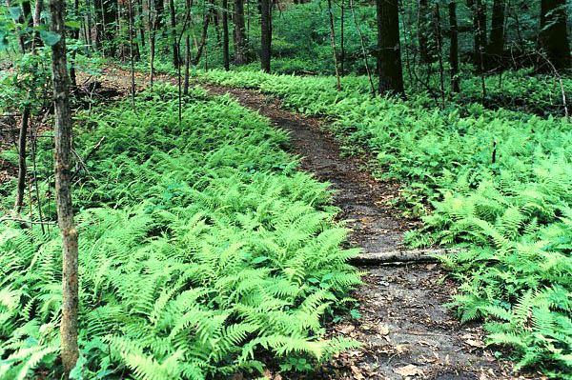
Ferns & Horsetails

Slide 16
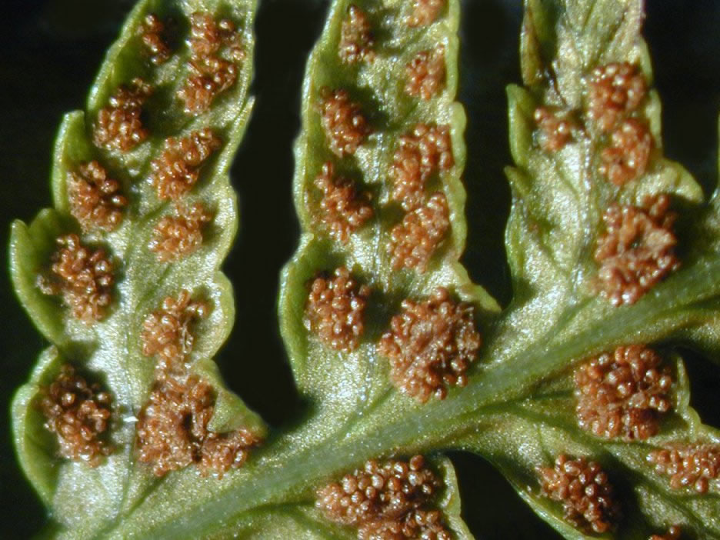
Ferns reproduce with spores

Slide 18
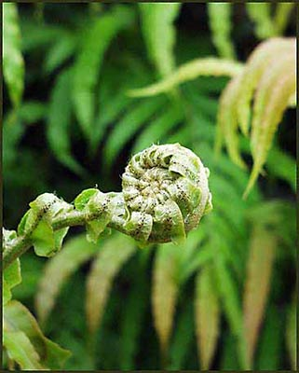
Fern frond

Slide 19
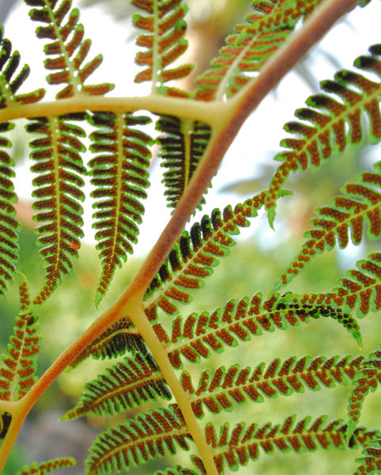

Slide 20
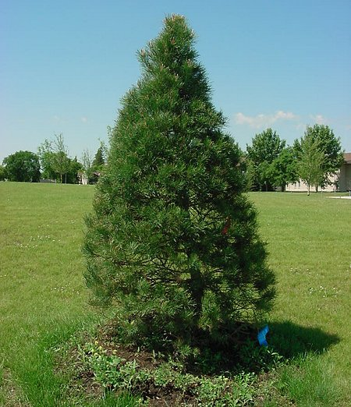
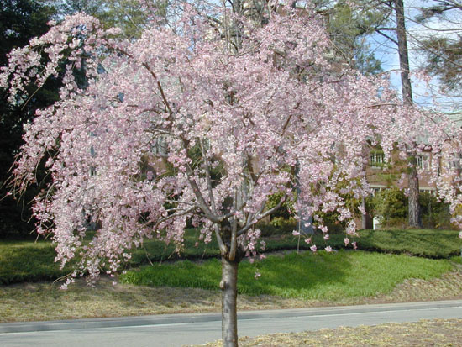
The Seed Plants:
Gymnosperms (cones) & Angiosperms (flowers)

Slide 21
Seed Plants
Seed plants produce seeds, which are reduced sporophyte plants within a protective coat
Seeds may be surrounded by a fruit -angiosperms
Seeds may be “naked” - gymnosperms

Slide 22
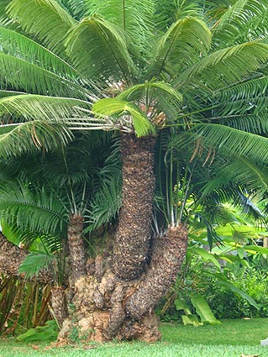
Gymnosperms (“naked seeds”)
Gymnosperm = “naked seed”
Have vascular tissue
Make seeds
Do not have flowers, but they do have cones

Slide 23
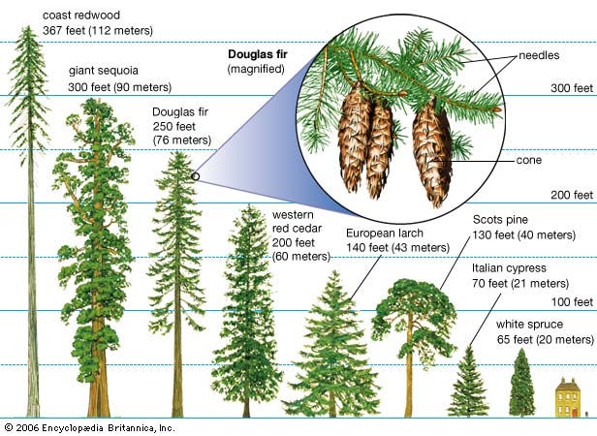
Gymnosperms – conifers (cone bearers)

Slide 24
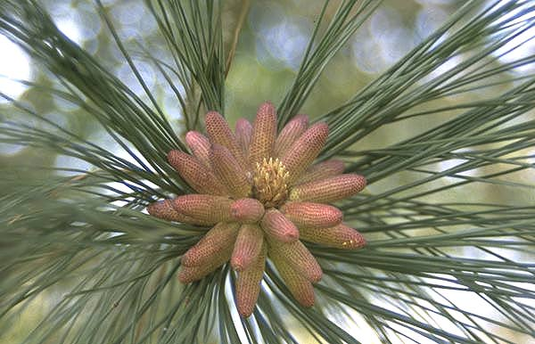
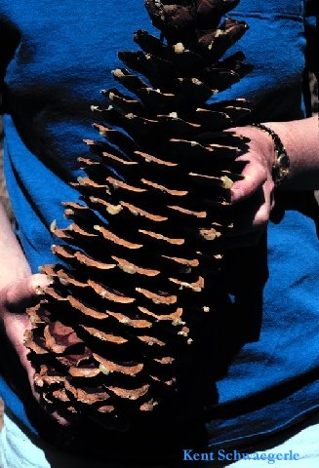
Gymnosperm cones…male and female. Which is which?

Slide 25
Gymnosperm cones…male and female. Which is which?
Male Female

Slide 26
Angiosperms
- Have vascular tissue
- Make seeds
- Have flowers
- The haploid (n) gametophyte stage is enclosed (almost entirely) within the diploid (2n) sporophyte structure

Slide 27
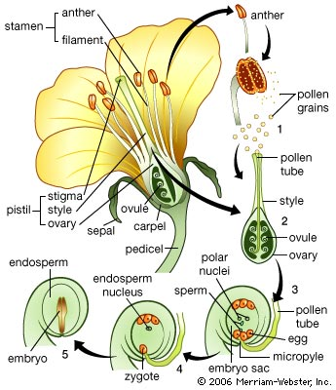
Angiosperms -
(Carpel)

Slide 28
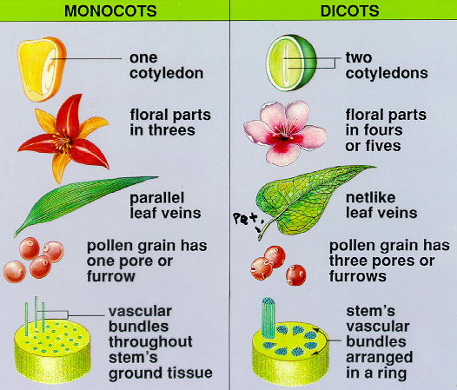
Angiosperms can be either
Monocots or Dicots

Slide 29
Angiosperms can be either
Monocots
- roots are fibrous
Dicots
- one big taproot

Slide 30
Types of plants summary
Mosses
  - Non vascular, seedless
2. Ferns
-vascular, seedless
3. gymnosperms (cone bearers)
-vascular, naked seeds
4. angiosperms (flowering plants)
-vascular, seeds surrounded by fruit

Slide 31
