Slide 1
Viruses

Slide 2
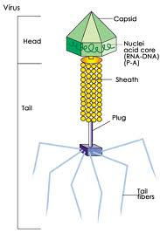
What is a virus?
A small infectious agent
Can replicate ONLY inside a LIVING cell (or host)
Can infect all types of organisms
Examples: HIV, Influenza A, West Nile

Slide 3
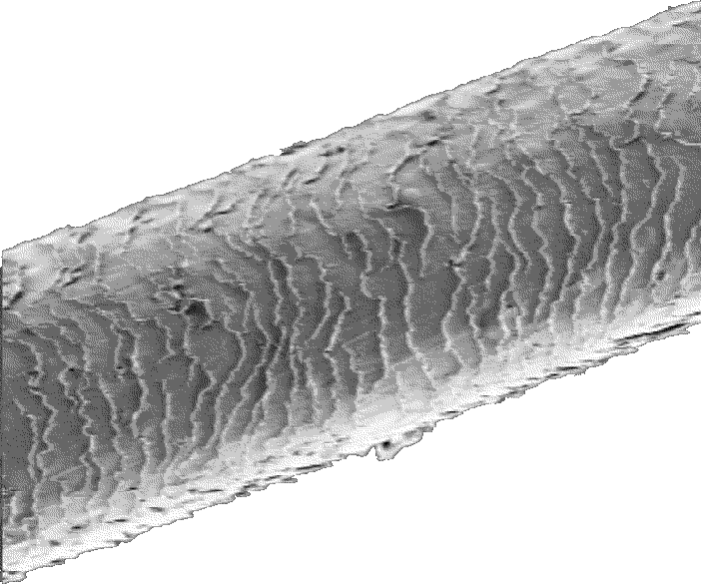
How big is a virus?
Viruses are very small
Usually 20-400 nanometers in size and cannot be seen with a light microscope
About 1000 viruses would fit across the width of a human hair!!
Is this larger or smaller than a bacterium???? (smaller)

Slide 4
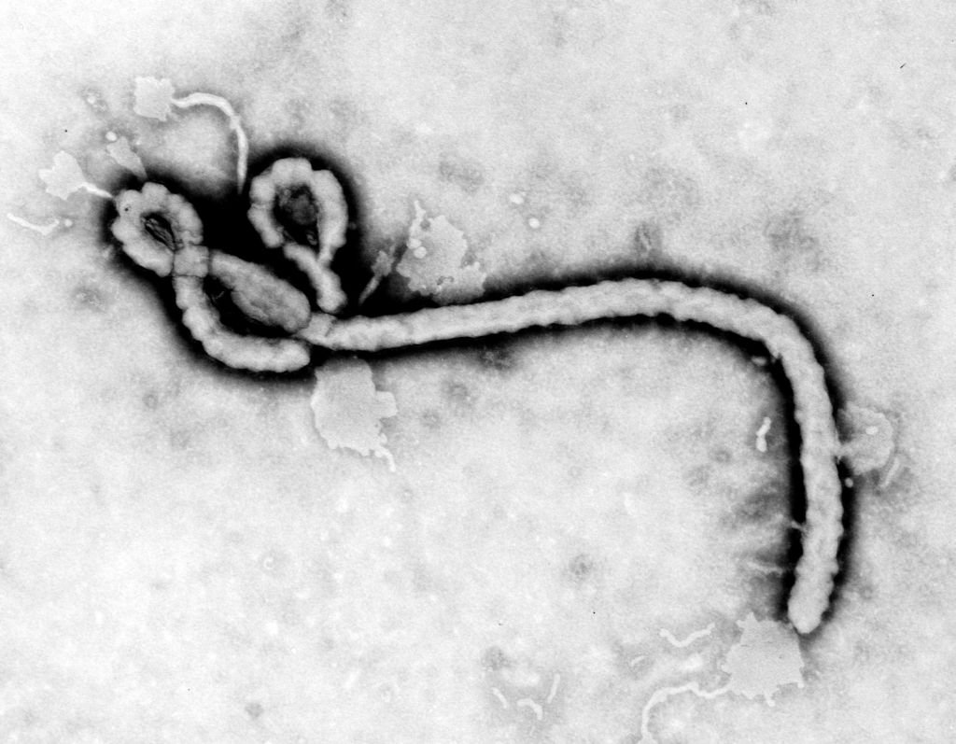
Are Viruses Living?
Cannot reproduce alone, must have a host cell
Do not undergo growth or development
Do not obtain or use energy
Evolve

Slide 5
Viruses cannot replicate on their own
Viruses are dependent on the help of host cells to reproduce
If you have a virus, the virus has become dependent on host cells in your body
Viruses are therefore known as obligate intracellular parasites
Meaning they MUST live inside a cell

Slide 6
Structure of a Virus
All viruses contain
1) A shell of protein called a capsid
2) Nucleic Acid which stores the information for the virus
This can be DNA or RNA
*Some viruses contain an additional layer outside the capsid called an envelope
The envelop allows the virus to attack cells in ‘stealth mode’

Slide 7
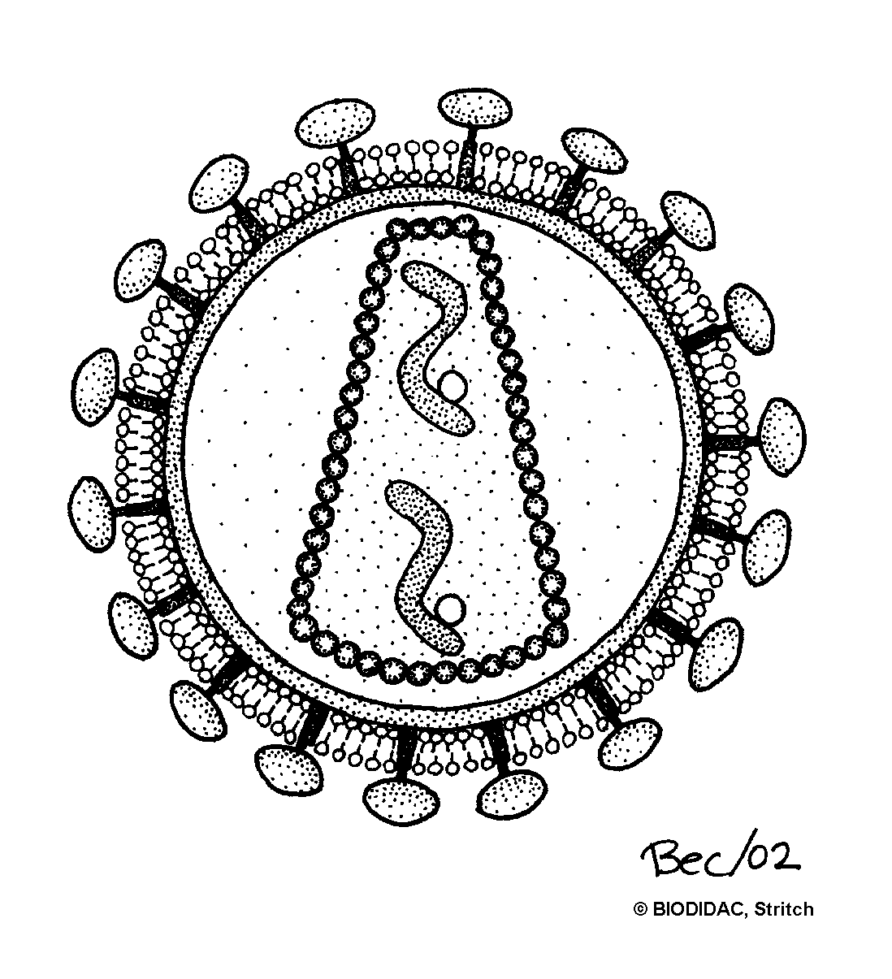
Structure of an Enveloped Virus
Nucleic Acid
Capsid
Envelope (this virus is in “stealth mode”)
http://biodidac.bio.uottawa.ca/thumbnails/filedet.htm?File_name=Viru008b&File_type=gif

Slide 8
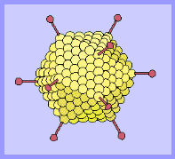
Adenovirus
Adenoviruses use special proteins that stick out from the capsid to attach to the host cell.
These are among the most common viruses.
Typical adenoviruses cause:
Sore throat
Pneumonia
Diarrhea
Pink eye
© Copyright Linda M Stannard, 1995. http://web.uct.ac.za/depts/mmi/stannard/emimages.html

Slide 9
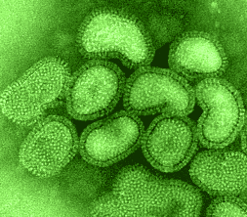
What do viruses look like?
Influenza Virus – the cause of the flu!
This is an RNA virus
© Copyright Linda M Stannard, 1995. http://web.uct.ac.za/depts/mmi/stannard/emimages.html

Slide 10
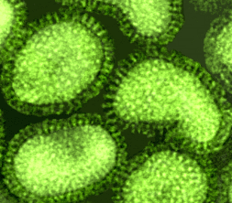
Influenza virus
Influenza virus has an envelope
Influenza killed over 20 million people in 1918-1919.

Slide 11
Retrovirus
Retroviruses have a very special enzyme called reverse transcriptase
Reverse transcriptase allows the virus to make DNA copies from RNA
The DNA then gets incorporated into the host genome

Slide 12
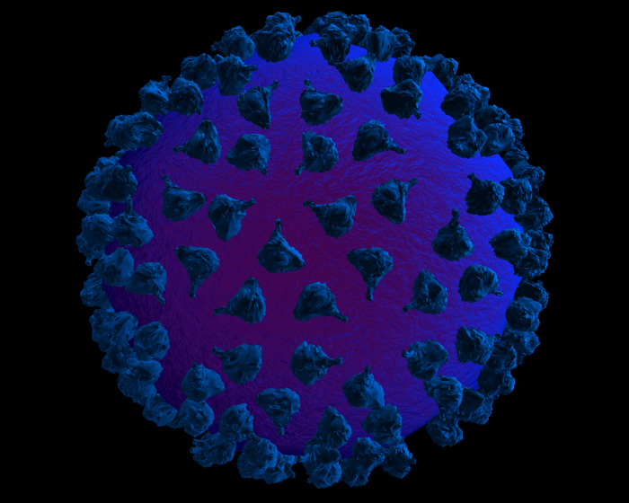
HIV is a Retrovirus
HIV has an envelope
HIV is an RNA virus
High mutation rate
http://research.amnh.org/exhibitions/epidemic/microbes.html

Slide 13
Two types of virus life cycles
1. Lytic Cycle
2. Lysogenic Cycle

Slide 14
The Lytic Cycle
1. The virus must attach to the host cell
2. The virus injects its nucleic acid (DNA or RNA) into the host cell
3. The host cell makes viral proteins from the viral nucleic acid
These can either destroy the host DNA, copy the viral DNA/RNA, or make more viral capsid proteins
4. Many new viruses assemble inside the cell

Slide 15
The Lytic Cycle
5. New virus cells are released from the cell
6. All of the many newly release viruses are free to infect other cells
7. The process repeats itself over and over again making us sick

Slide 16
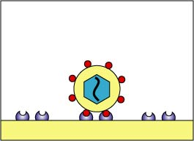
How do viruses work? The basic steps of the Lytic Cycle
1. The virus must attach to the host cell
http://www.cat.cc.md.us/courses/bio141/lecguide/unit2/viruses/u2fig5a.html

Slide 17
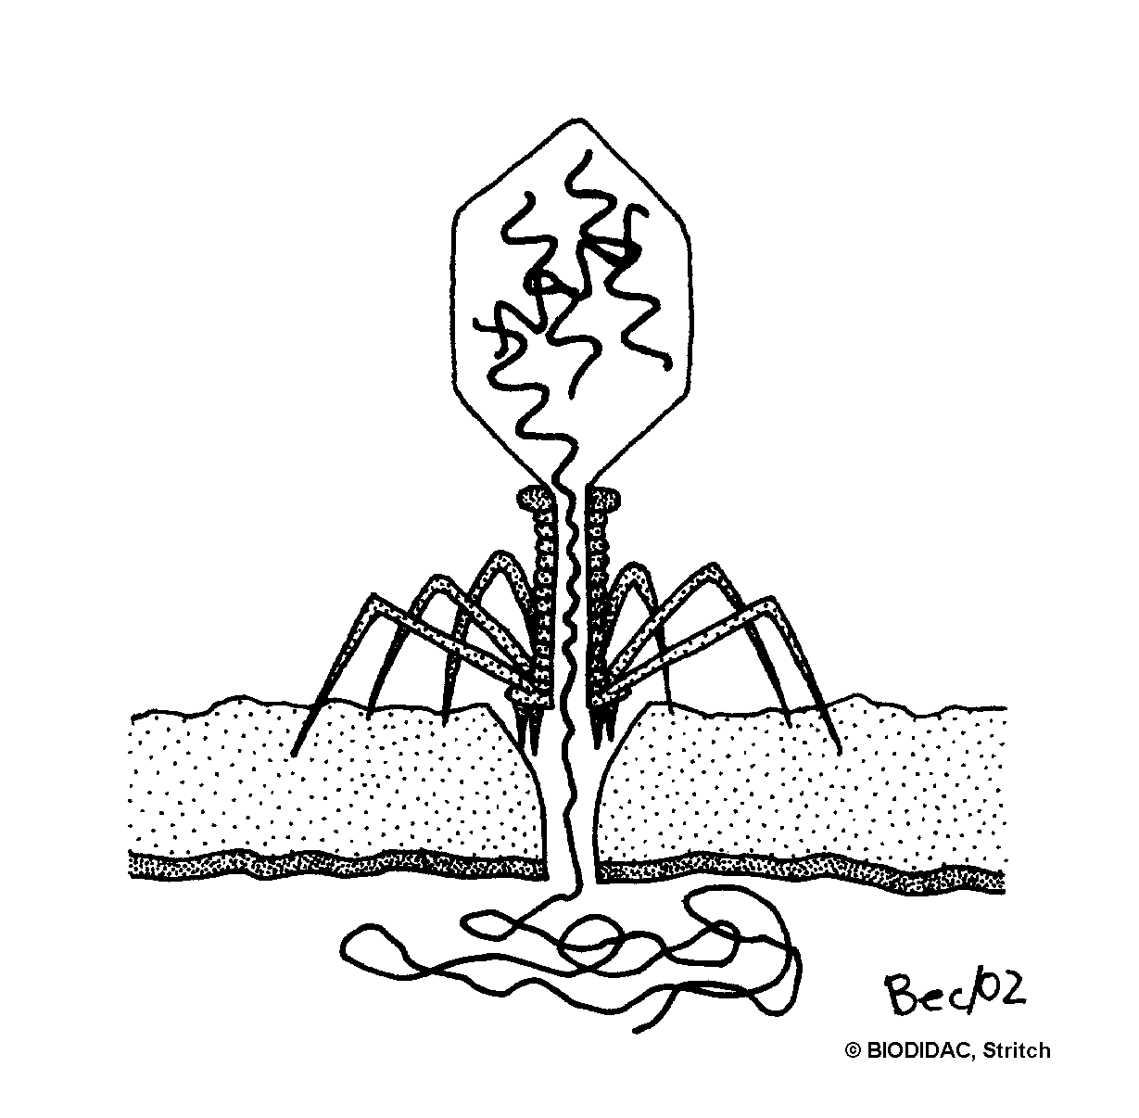
How do viruses work? The basic steps of the Lytic Cycle
2. The virus injects its nucleic acid (DNA or RNA) into the host cell

Slide 18
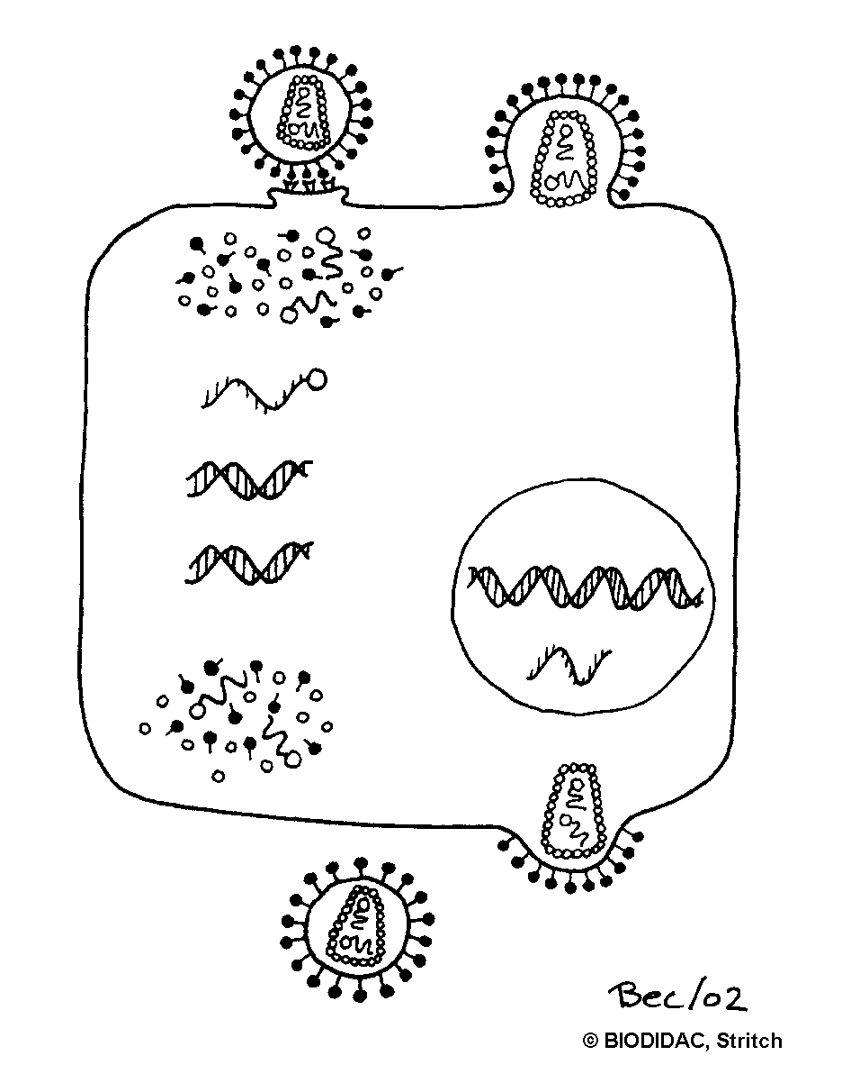
How do viruses work? The basic steps of the Lytic Cycle
3. The host cell makes viral proteins from the viral nucleic acid which:
Destroy the host DNA
Copy the viral nucleic acid
Make more viral capsid proteins

Slide 19
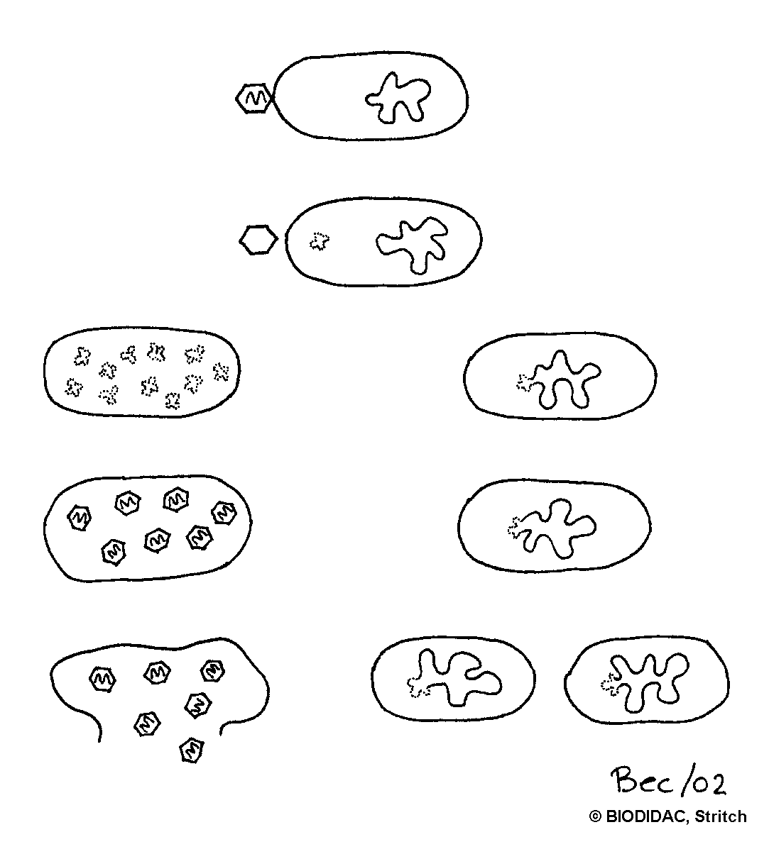
How do viruses work? The basic steps of the Lytic Cycle
4. Many new viruses assemble inside the cell

Slide 20
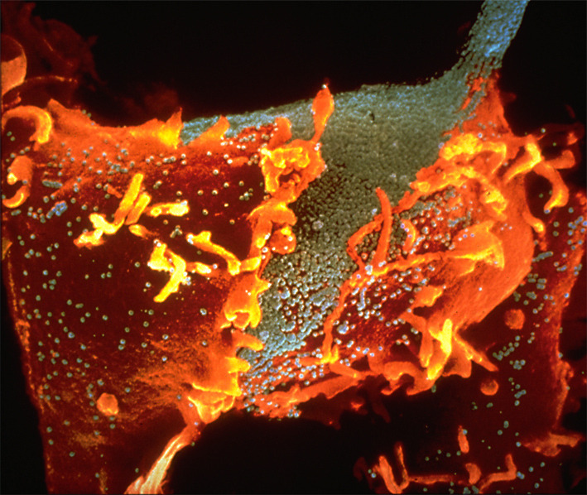
How do viruses work? The basic steps of the Lytic Cycle
5. New viruses are released from the cell in two ways:
a) Non-enveloped viruses usually cause the host cell to burst
The cell is beginning to burst because of all of the emerging viruses
http://www.aids-info.ch/e_te/aas-e-imm.htm
(Lennert Nilsson, Karolinska Inst., Stockholm) © Boehringer Ingelheim International GmbH

Slide 21
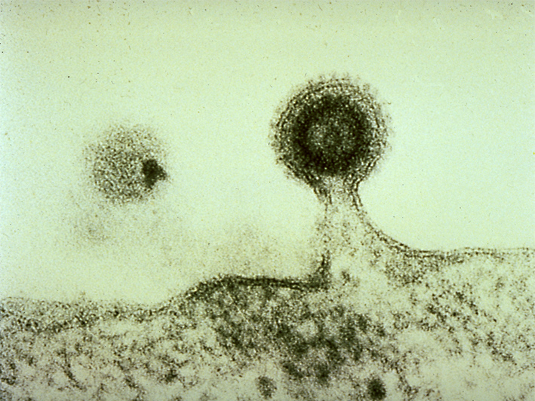
How do viruses work? The basic steps of the Lytic Cycle
OR…
b) Enveloped viruses usually leave the infected cell by budding
Virus budding off the cell membrane
http://www.aids-info.ch/e_te/aas-e-imm.htm
(H.R. Gelderblom, Robert-Koch-Institut, Berlin)

Slide 22
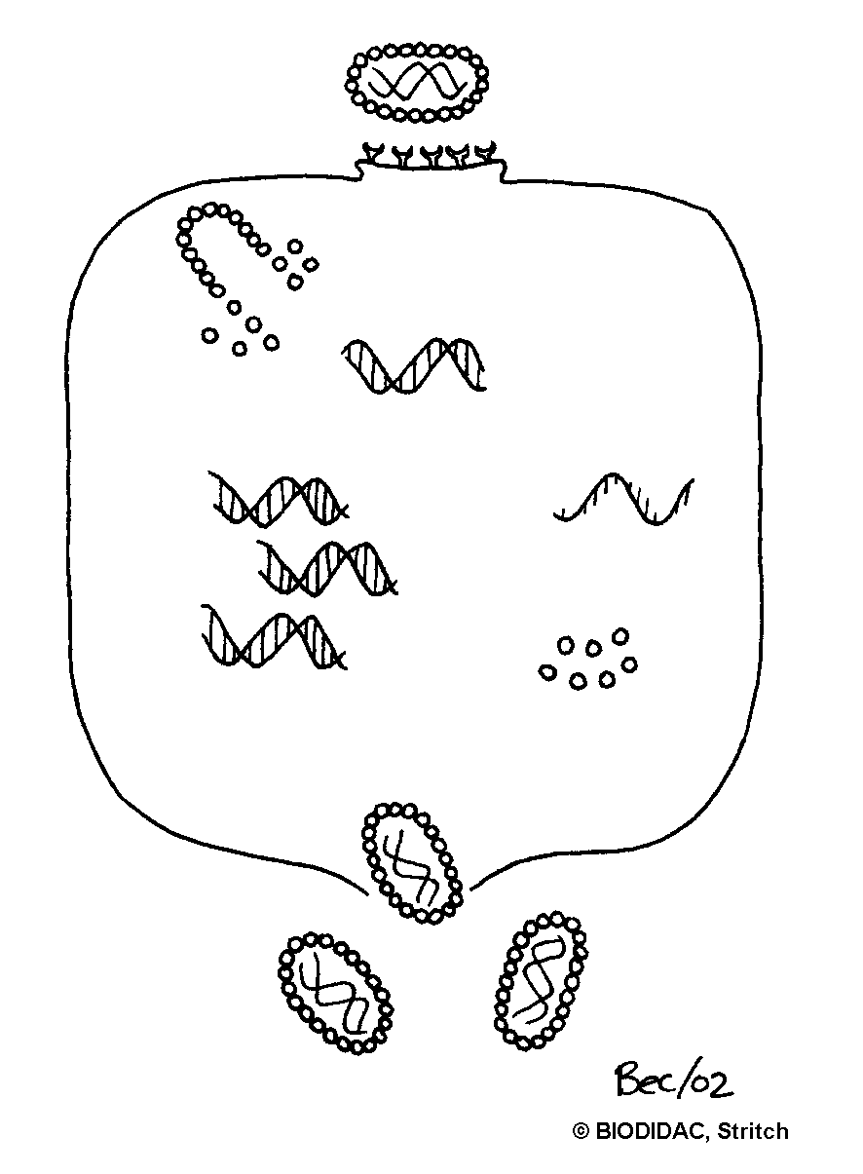
How do viruses work? The basic steps of the Lytic Cycle
6. All of the many newly released viruses are free to infect lots of other cells!!

Slide 23
How do viruses work? The basic steps of the Lytic Cycle
7. The process then repeats itself over and over again, making us sick.

Slide 24
Lytic Cycle
Lytic cycle is faster and simpler
Ex: the flu
A virus with this type of cycle makes you sick right away
What about the other type of life cycle?

Slide 25
The Lysogenic Cycle
The lysogenic cycle is slower and more complex
Ex: Herpes
If a virus has this type of life cycle it can ‘hide out’ in the DNA of your cells until it is ready to attack
This type of virus can keep reoccurring

Slide 26
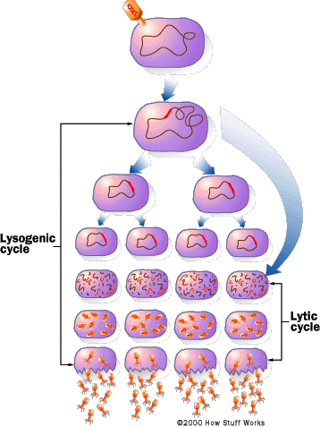
The Lysogenic Virus Cycle
The viral DNA integrates into the DNA of the host cell
it becomes part of the host chromosome
When its DNA is inside the host DNA it is called a provirus.

Slide 27
The Lysogenic Virus Cycle
Then every time the host cell reproduces, it copies all of its DNA…including the provirus!!!
So each new host cell will contain the provirus!!!

Slide 28
The Lysogenic Virus Cycle
Temperature
Stress level
Immune system weakness
Then when conditions are right, the provirus will activate the lytic cycle.
The viral DNA makes viral proteins
Virus destroys host DNA
New viruses burst cell and spread
Virus replicates

Slide 29
The Lysogenic Virus Cycle
Because lysogenic viruses can “lurk” in host cell DNA, they can be difficult for the body to eradicate
As a result, they can stay inside cells as proviruses and can keep causing infections

Slide 30
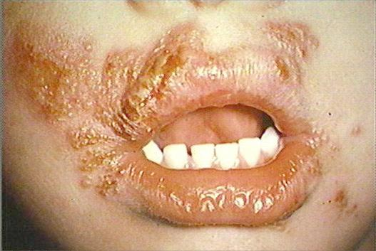
The Lysogenic Virus Cycle
Example = herpes “cold sores” that keep infecting the mouth
Herpes may “go away” temporarily, but as long as the provirus lurks in the DNA of your mouth cells, they can enter the lytic cycle to make you miserable

Slide 31
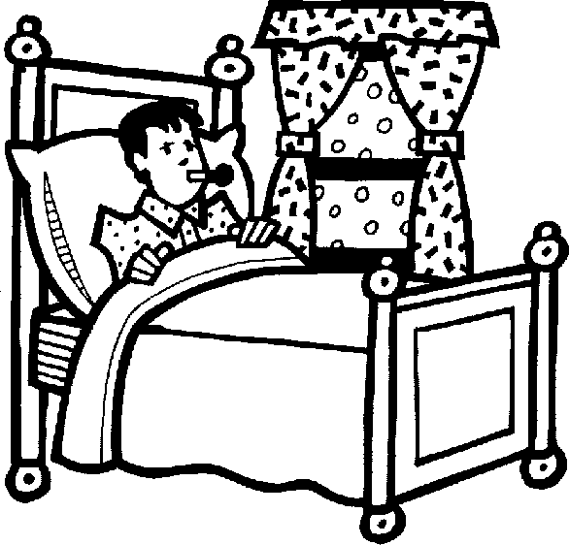
How do viruses make us sick?
1. By destroying our cells when newly assembled viruses are ready to spread to other cells
2. By causing our immune system to respond in a way that gives us symptoms
3. By making it easier for other pathogens—such as bacteria—to infect us
4. By promoting cancer in our bodies

Slide 32
What is a vaccine? How does that help prevent viruses from infected us?

Slide 33
We can “help” our immune system to produce antibodies by using vaccines
Important vocabulary in understanding vaccines:
Immune response: your body’s defenses that attack a disease-causing agent (pathogen)
Antigen: a substance (such as a virus or bacterium) that triggers an immune response

Slide 34
When you receive a vaccine you are injected with either:
An “inactivated” or “killed” pathogen
An antigenic part of the pathogen (such as part of the cell wall or flagellum)
A living but weakened version of the pathogen
This is the most effective type of vaccine, but why might it not be advisable for patients with weakened immune systems???

Slide 35
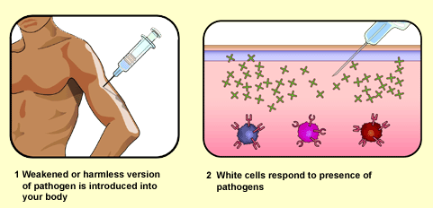
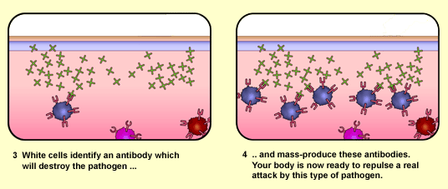
http://www.bbc.co.uk/gcsebitesize

Slide 36
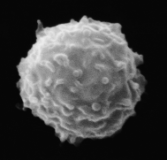
Once you receive the vaccination…
Your immune system responds in two ways:
1) Some of the cells of your immune system produce antibodies that bind to the disease-causing organism…eventually leading to its death.
2) Memory cells are formed that “remember” what the antigen looked like

Slide 37
These memory cells are key…
Because the next time you get the disease, these memory cells recognize the antigen and produce antibodies VERY QUICKLY
The quicker your immune system responds, the less sick you get…

Slide 38
Important viral diseases with vaccines
Chickenpox
Smallpox
Measles
Mumps
Rubella
Influenza
Polio
Hepatitis A
Hepatitis B
We currently DO NOT have vaccines for HIV or the common cold

