Slide 1
Lytic Cycle
Lytic cycle is faster and simpler
Ex: the flu
A virus with this type of cycle makes you sick right away
What about the other type of life cycle?

Slide 2
The Lysogenic Cycle
The lysogenic cycle is slower and more complex
Ex: Herpes
If a virus has this type of life cycle it can ‘hide out’ in the DNA of your cells until it is ready to attack
This type of virus can keep reoccurring

Slide 3
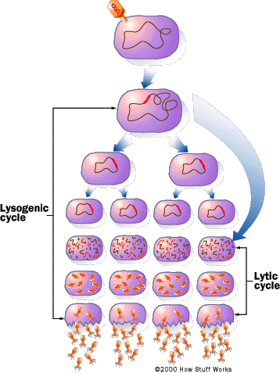
The Lysogenic Virus Cycle
The viral DNA integrates into the DNA of the host cell
it becomes part of the host chromosome
When its DNA is inside the host DNA it is called a provirus.

Slide 4
The Lysogenic Virus Cycle
Then every time the host cell reproduces, it copies all of its DNA…including the provirus!!!
So each new host cell will contain the provirus!!!

Slide 5
The Lysogenic Virus Cycle
Temperature
Stress level
Immune system weakness
Then when conditions are right, the provirus will activate the lytic cycle.
The viral DNA makes viral proteins
Virus destroys host DNA
New viruses burst cell and spread
Virus replicates

Slide 6
The Lysogenic Virus Cycle
Because lysogenic viruses can “lurk” in host cell DNA, they can be difficult for the body to eradicate
As a result, they can stay inside cells as proviruses and can keep causing infections

Slide 7
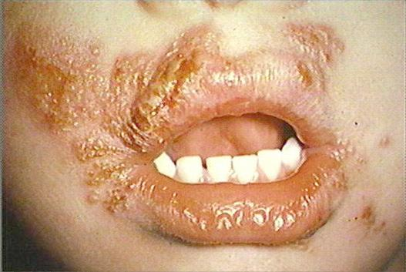
The Lysogenic Virus Cycle
Example = herpes “cold sores” that keep infecting the mouth
Herpes may “go away” temporarily, but as long as the provirus lurks in the DNA of your mouth cells, they can enter the lytic cycle to make you miserable

Slide 8
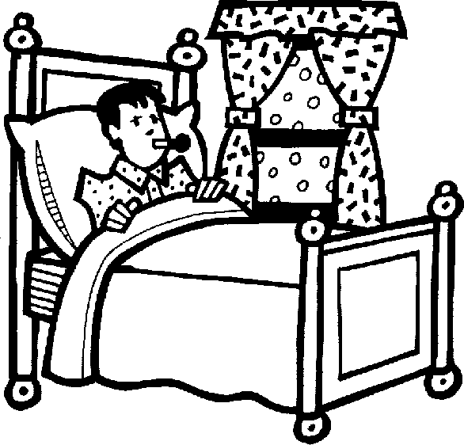
How do viruses make us sick?
1. By destroying our cells when newly assembled viruses are ready to spread to other cells
2. By causing our immune system to respond in a way that gives us symptoms
3. By making it easier for other pathogens—such as bacteria—to infect us
4. By promoting cancer in our bodies

Slide 9
What is a vaccine? How does that help prevent viruses from infecting us?

Slide 10
We can “help” our immune system to produce antibodies by using vaccines
Important vocabulary in understanding vaccines:
Immune response: your body’s defenses that attack a disease-causing agent (pathogen)
Antigen: a substance (such as a virus or bacterium) that triggers an immune response

Slide 11
When you receive a vaccine you are injected with either:
An “inactivated” or “killed” pathogen
An antigenic part of the pathogen (such as part of the cell wall or flagellum)
A living but weakened version of the pathogen
This is the most effective type of vaccine, but why might it not be advisable for patients with weakened immune systems???

Slide 12
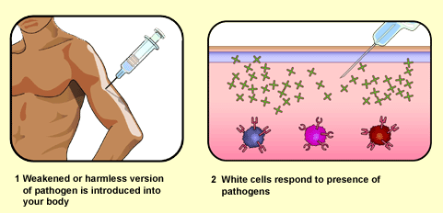
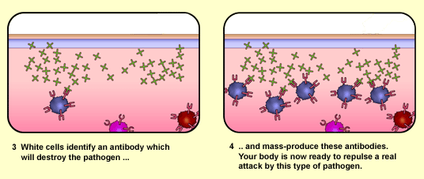
http://www.bbc.co.uk/gcsebitesize

Slide 13
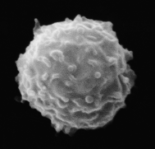
Once you receive the vaccination…
Your immune system responds in two ways:
1) Some of the cells of your immune system produce antibodies that bind to the disease-causing organism…eventually leading to its death.
2) Memory cells are formed that “remember” what the antigen looked like

Slide 14
These memory cells are key…
Because the next time you get the disease, these memory cells recognize the antigen and produce antibodies VERY QUICKLY
The quicker your immune system responds, the less sick you get…

Slide 15
Important viral diseases with vaccines
Chickenpox
Smallpox
Measles
Mumps
Rubella
Influenza
Polio
Hepatitis A
Hepatitis B
We currently DO NOT have vaccines for HIV or the common cold

Slide 16
How do we treat bacterial infections?

Slide 17
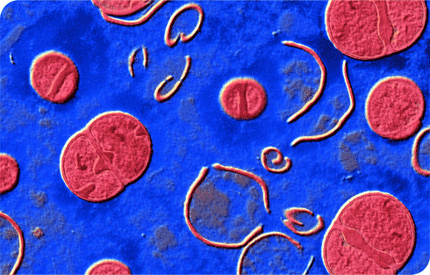
Antibiotics
-This is the effect of the antibiotic drug ceftazidine on Staphylococcus aureus bacteria.
-The antibiotic kills the bacteria (red) by causing the cell wall to disintegrate (yellow remnants).

Slide 18
Human Immunodeficiency Virus (HIV)
How many people have HIV?
What is HIV? Virus or Bacteria?
How do you get HIV?
How does it affect your body?
How do we treat it?

Slide 19
Prevalence of HIV
http://www.cdc.gov/vitalsigns/hivtesting/
In the United States:
Age (Years) and Estimated Number of Diagnoses of HIV Infection, 2011
Under 13 | 192
Ages 13-14 | 52
Ages 15-19 | 2,240
Ages 20-24 | 8,054
Ages 25-29 | 7,484
Ages 30-34 | 6,209
Ages 35-39 | 5,285
Ages 40-44 | 5,753
Ages 45-49 | 5,564
Ages 50-54 | 3,951
Ages 55-59 | 2,312
Ages 60-64 | 1,229

Slide 20
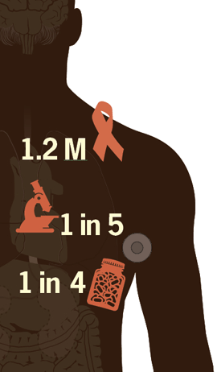
1.2 Million people in the US living with HIV
1 in 5 people infected do not know they have HIV
1 in 4 are not taking the proper medication
*http://www.cdc.gov/vitalsigns/hivtesting/

Slide 21
What is HIV?

Slide 22
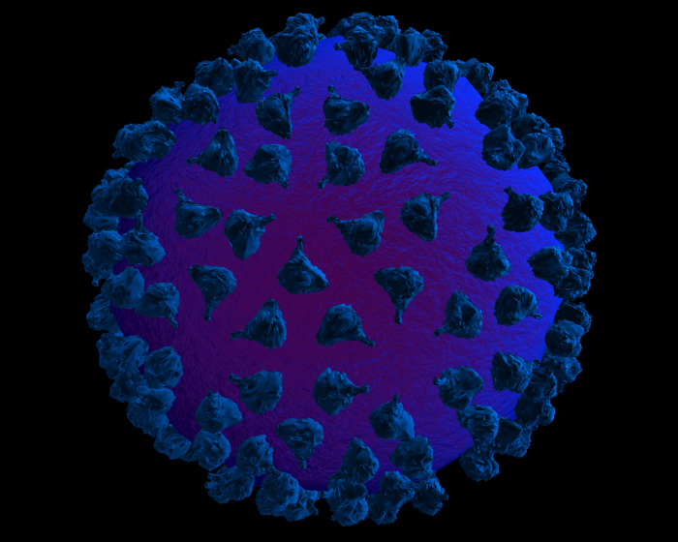
HIV is a Retrovirus
HIV has an envelope
HIV is an RNA virus
High mutation rate
http://research.amnh.org/exhibitions/epidemic/microbes.html

Slide 23
How is HIV transmitted?
HIV is transmitted through body fluids
Usually from blood, semen, vaginal secretions and breast milk
Fluid surrounding the spinal cord and brain, bone joints, and amniotic fluid surrounding unborn babies
HIV has been found in low quantities in tears and saliva but has never been shown to result in transmission

Slide 24
How is HIV transmitted?
Sexual contact with an infected person (unprotected sex)
Infusion of contaminated blood (blood transfusions, sharing needles, accidental prick from HIV-contaminated needle)
The U.S. blood supply was tested for HIV beginning in 1985
Transfer of the virus from an infected mother to child before birth, during birth, or after birth through the mother’s milk

Slide 25
What’s the difference between HIV and AIDS?
Definition of AIDS: Acquired immunodeficiency syndrome is defined on the basis of its clinical manifestations.
You have AIDS when you show symptoms of severe immune deficiency
This becomes apparent through opportunistic infections, CD4 count, and viral load

Slide 26
Latent Period
HIV has a long latent period (8-10 years)
A latent period is when the virus is present in your body but you do not have any symptoms
Many people have HIV but do not know they are infected
HIV can still be transmitted during the latent period, therefore many people transmit HIV to others before they know they are infected

Slide 27
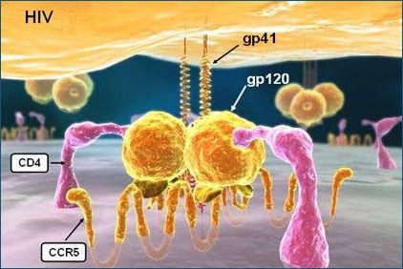
What does HIV do in the body?
HIV directly attacks your CD4 cells (part of cell-mediated immunity)
CD4 cells are part of your immune system that fight off infection

Slide 28
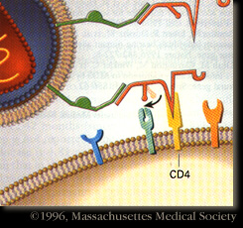
What does HIV do in the body?
Since the body can detect the virus in CD4 cells, the immune system responds by destroying those CD4 cells
The HIV virus also destroys CD4 cells
The destruction of CD4 cells weakens the immune system
This destruction comes from the virus directly killing the cell OR the immune system killing the cell

Slide 29
How do we treat HIV?
The problem: high mutation rate, long latent period, integrated viral DNA (lysogenic!)
There is no vaccine for HIV/AIDS
Many prevention methods for AIDS
Examples?

Slide 30
How do we treat AIDS? - AZT
Azidothymidine- first FDA approved treatment for HIV
AZT is a Nucleoside Reverse Transcriptase Inhibitor (NRTI)
AZT inhibits HIV synthesis by binding to reverse transcriptase to make it non-functioning
This stops the copying of RNA to DNA and therefore stops the viral DNA from being incorporated into host DNA (think back to lytic cycle steps!)

Slide 31
How do we treat HIV?
Protease inhibitors- block the enzyme “Protease” that assembles new viral particles
When protease is blocked, new viruses cannot form
Entry Inhibitors- block the attachment of HIV to CD4 cells.
Works by targeting specific proteins on the surface of HIV
Most recent for of therapy for HIV
HAART- “highly active antiretroviral therapy”
Combination of a variety of antiretroviral medication. For example: Many patients are on a NRTI and a Protease Inhibitor
Combination of multiple medicines has lengthened life expectancy for AIDS patients

Slide 32
